Slide 1
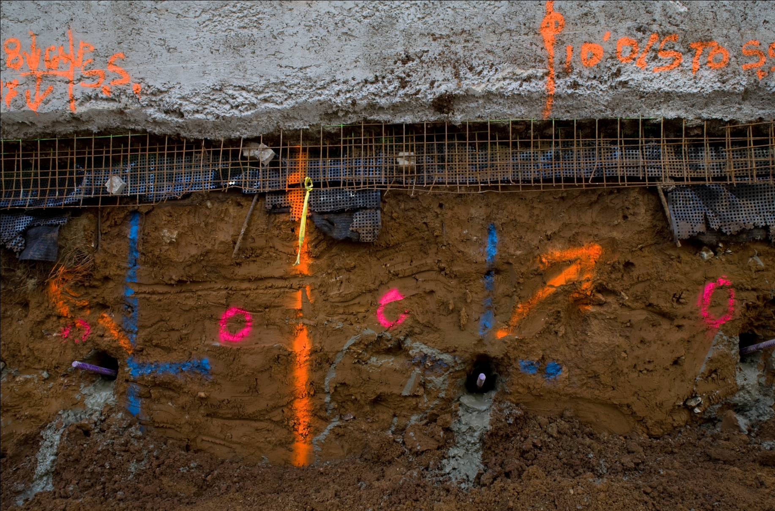
…the University of California Experiments in Lean Project Delivery
UCSF Capital Programs
Presented by Glenn Ballard for Michael Bade
Assistant Vice Chancellor and Campus Architect
…or, how we learned to eat our home cooking!
August 29, 2012
Notes:
Address UCSF commitment to collaboration, connection to UCB P2SL

Slide 2
When and Why
UCSF had two challenging projects ramp up in 2006:
Cardiovascular Research Building
Regeneration Medicine Building
We had recently seen a major research building project get stopped by a challenging construction cost environment
Many of our major projects landed in litigation before completion
Major trade subcontractors didn’t want to work with UCSF
We set high design and construction standards for our cutting-edge research facilities

Slide 3
Public Sector Challenges
No Multi-party Agreements – cannot use private sector multi-party IFOA (Integrated Forms of Agreement)
Use prequalification to assure bidder pools are closely aligned with project goals and objectives
Best Value legislation changed the game for UCSF – major private-sector players sought work in confidence they would compete based on project objectives and team capabilities/qualifications rather than strictly on cost
Front-end lead time lengthened due to complexity and detail in prequal and bid processes
Must maintain open stance – cannot draw prequal or Best Value processes so tightly that competent firms are excluded
Importance of addressing change through construction industry organizations

Slide 4
Where We Started
Connected with P2SL at UCB, Glenn Ballard
Joined Lean Construction Institute
Saw results of early Lean projects for Sutter Health, others
Developed Lean CM@Risk w/ D-B subs and incentives contract for $254 million Cardiovascular Research Building
Developed Lean D-B contract for $123 million Regeneration Medicine Building

Slide 5
Cardiovascular Research Building

Slide 6
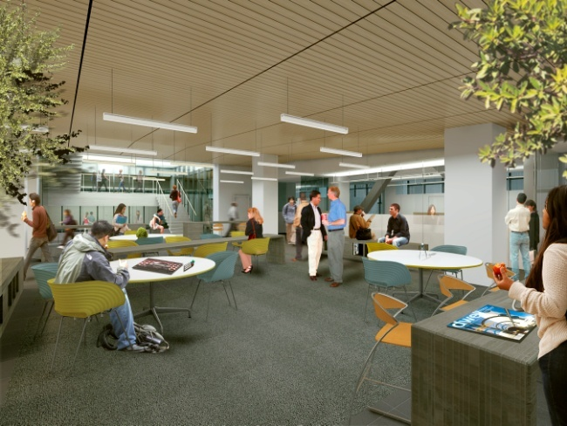
Six Key Concepts
Picking The Team
Integrating Technology
Communication
Lean Process & Metrics
Dispute Resolution
Incentives
Notes:
Shannon

Slide 7
CVRB Team Organization
Owner
UCSF
Cambridge CM
All Other Trades
(lump sum bid)
Contractor
Rudolph and Sletten
Architect
SmithGroup
Jim Jennings
Structural Eng.
Rutherford
& Chekene
Exterior Skin
Walters & Wolf
Lab Planners GPR
Electrical
Rosendin
All Other Design Consultants
Mechanical/
Plumbing
Southland
Notes:
Sandra

Slide 8
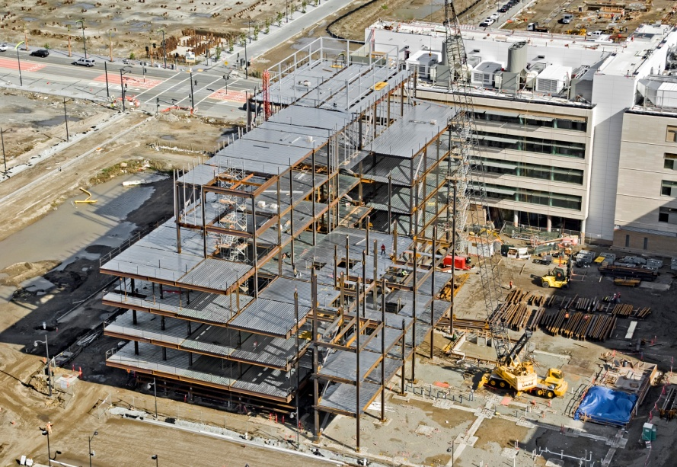
Best Value Selection
Evaluate Contractors for:
Categories:
Management Capability
Safety
Financial Strength
Labor Compliance
Relevant Experience
Evaluations are by Points Earned in Each Category
Divide Points into Bid
Award Based on Lowest Cost Per Quality Point
Notes:
Shannon
UCSF is the only campus in the UC system being used as the test pilot for a BV selection. It’s basically a way of taking qualification into account when analyzing bids in a very quantitative way. It’s a very prescribed system where projects are allowed to score bidders based on these five categories. As part of the bid documents we sent out a best value questionnaire which is basically like an RFP asking the contractors to submit information aligning with these five categories. The goal for us was to have the contractors demonstrate their experience and success on previous similar project. An example is that we asked them to submit estimates from various stages in projects to demonstrate how they could manage a project to a budget in a IPD environment. What R&S did was submit estimates at various stages from a single project, at the end of DDs, CDs, buyout and at the end of construction to show that they could in fact help manage a project to a budget in an IPD environment. After the responses from the contractor are scored the bids are divided by the score in a blind way and the bid is awarded to the bidder with the lowest cost per point.

Slide 9
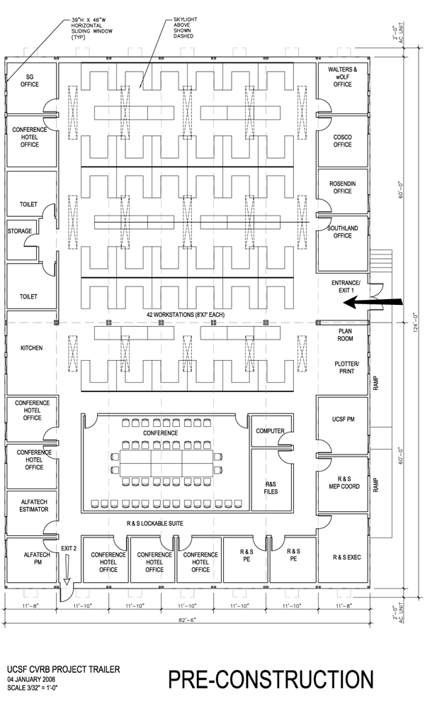
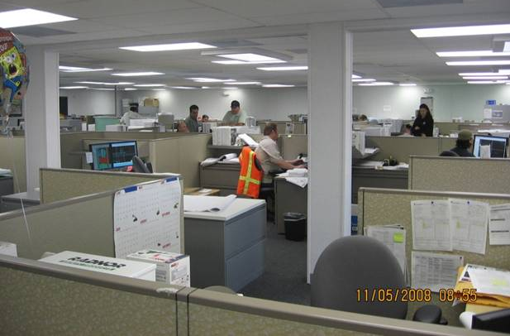
Big Room – Creating the Tone
SMITHGROUP
CAMBRIDGE
SOUTHLAND
UCSF
ROSENDIN
All Key Members in one trailer
Team Approach Encouraged by owner
Blurring the lines working as a team
IOR
COMMON PROJECT VISION
W&W
RUDOLPH & SLETTEN
Notes:
Shannon

Slide 10
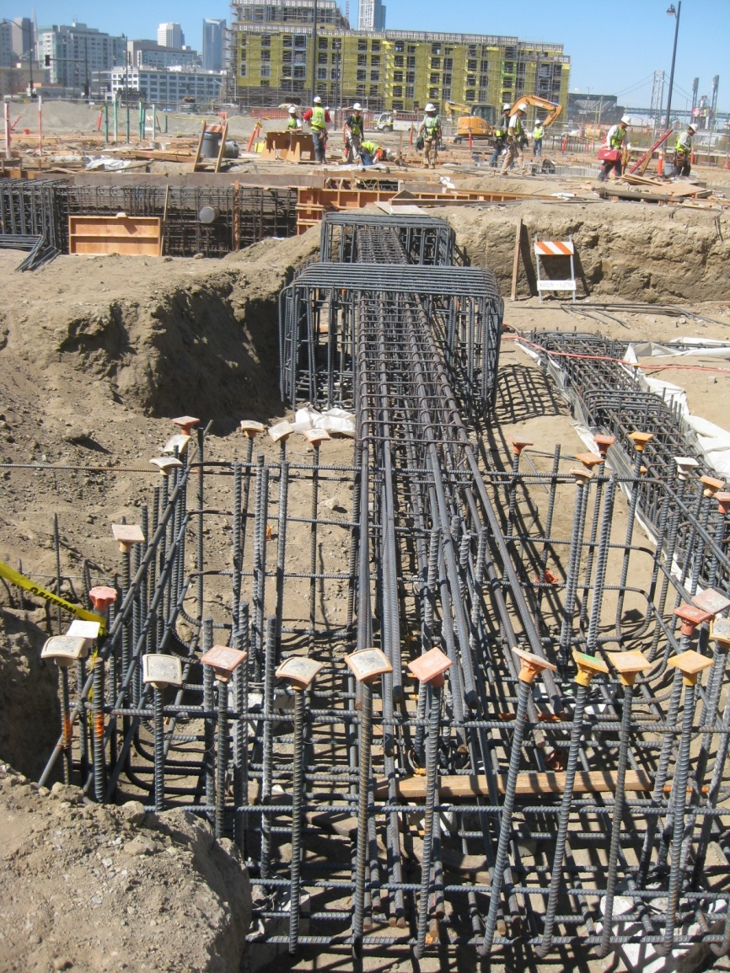
Dispute Resolution
Clear, Fair, Process Everyone Can Agree to
Set Clear Time Frames
Emphasize a Collaborative Approach
Review Key Project Process & Modify if Necessary
Can escalate to committee of project executives
Notes:
Danielle

Slide 11
Integrating Technology
Whole Team in BIM
BIM Coordination = More Exchange of Ideas, Increased Commitment
Facilities Group on BIM
Define Team Member Roles in Coordination
Foster Trust to Enable Good Performance & Collaborative Approach
BIM is a tool which makes IPD possible
Notes:
Lumi
Does everyone know what BIM is? Stands for Building information modeling and it’s a term that describes designing with several recently available software packages that allow architects to design in 3D. Traditionally design has been done with autoCAD where you are essentially draft with lines on your computer. BIM software packages are object based where instead of drawing lines you place objects in the model that have properties. For example instead of drawing lines that represent a door you pick a door from a catalogue of objects and drop it in the model. The door object has information embedded that tells you what type of materials it’s made of what the hardware is, etc.
This was the first major project SG did in Revit. The structure was done in Revit structures, so the architecture and structure were designed in BIM from the very beginning.
Each of the five key disciplines has their own model (M,E,P,A,S) and those models are brought together in a software package called NavisWorks for coordination.
Having the design in BIM allows you to use the model not only for clash detection but also for 4D simulations, and estimating.

Slide 12
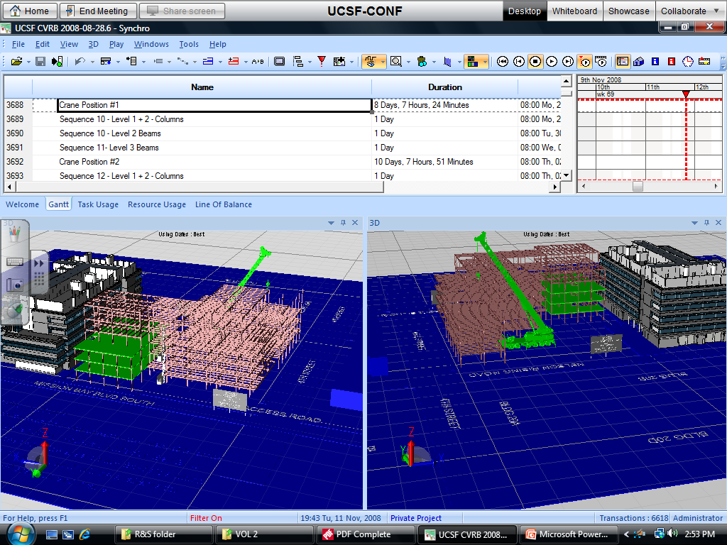
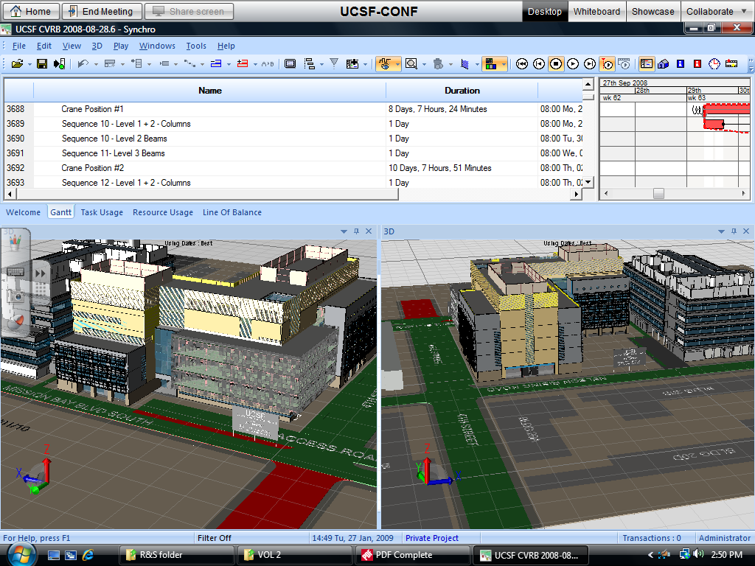
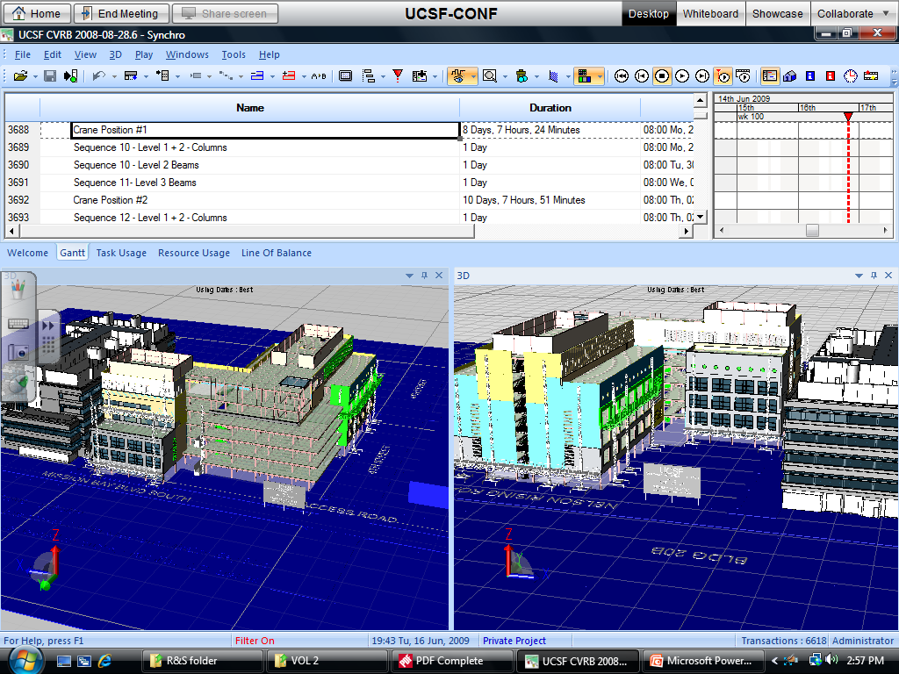
Integrating Technology – 4D
Notes:
Danielle
As I mentioned another tool we used our BIM model for was a 4D simulation. This is a screen shot of Syncro- a software package that allows you to link objects in your model directly to activities in your CPM schedule then run the progress of construction as a simulation over time. We did this primarily to analyze the site logistics of how our skin system would go up at the same time there was utility and street improvement work going on around the building.
One thing to note about all the BIM stuff is that the programs take an incredible amount of computer power. There is a BIM consulting firm named View by View that helped us put this simulation together. He had a custom laptop that was a very high end computer. The first time he came to show us this simulation he came into the conference room, sat down to show us his progress and smoke literally started billowing out of his computer. . . You need new powerful computers just to run the programs.

Slide 13
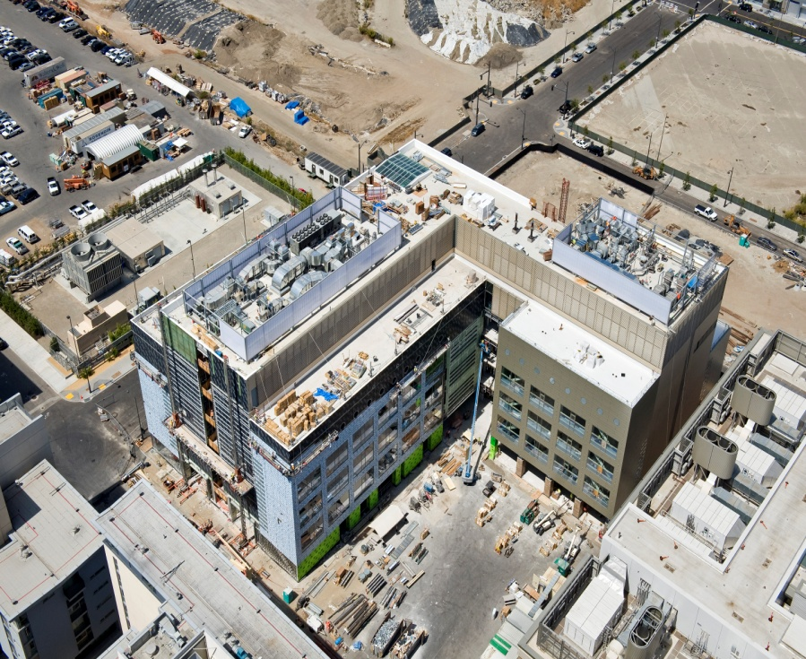
Incentive –Pre Construction
Target Cost & Complete Buyout Incentive
Total Construction Cost at Bid
Must be Between
Anticipated Contract Value
($175M)
+ 2% or -5%
Notes:
Shannon

Slide 14
Incentive –Pre Construction
. . . And If
Target Cost & Complete Buyout Incentive
Total Cost at Bid
At end of Construction
Scope Gap COs
less than .5%
+
Constructability Omission COs
less than .5%
Then
Complete Buyout Incentive Achieved
Notes:
Shannon

Slide 15
Incentive – Construction
Percent Planned Complete & Schedule Milestone Based Incentive Program
Performance Based Incentives
Sharing Risk and Reward
Set Up a Way to Share the Reward
Everyone Fails Together or Succeeds Together
Notes:
Danielle

Slide 16
Schedule Milestones

Slide 17
Weekly Plan Percent Complete

Slide 18
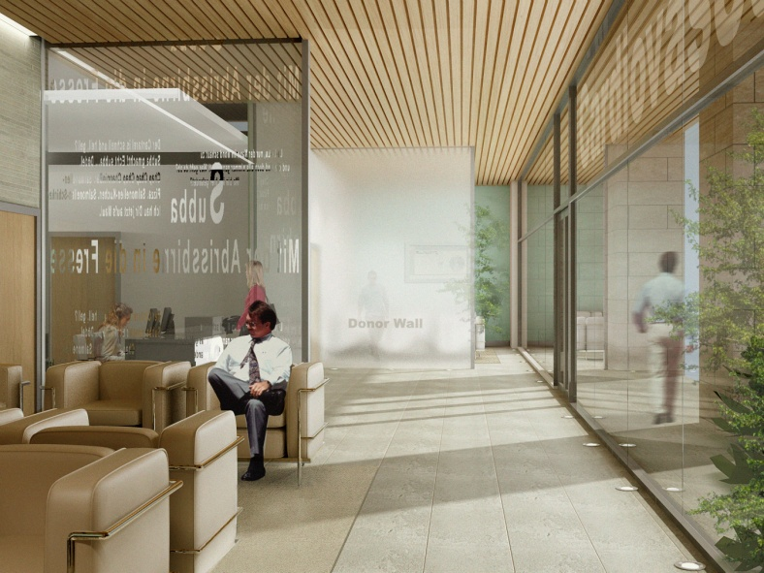
Benefits
Accurate Buy-out at Target Cost
Improved Schedule Performance
Greatly Reduced Risk of Claims
Improved Design Process
Improved Risk Management Process During Construction
Improved Communications With Stakeholders
Decrease in RFI’s and Submittal Turn Around
Faster Decision Making
Greatest benefit is a successful project for the entire team
Notes:
Sandra

Slide 19
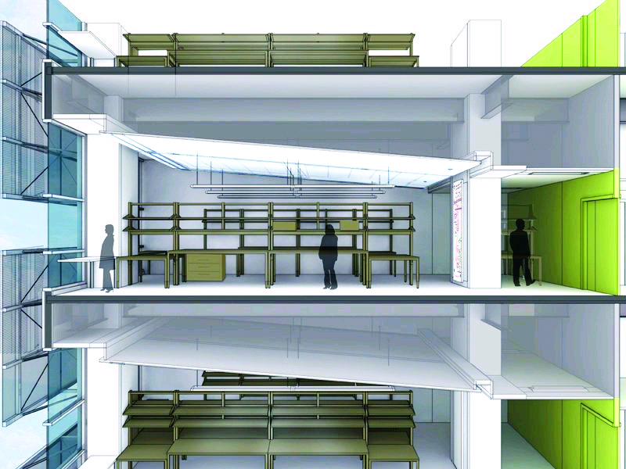
Benefits
Cost Control from Beginning via Integrated Team
Everybody’s ideas contribute
Early Integration of Installation Criteria Lowered Risk for Owner
Constructability Resolved Early During Design Stages
Predictability of Planning Fewer Surprises
Greatest benefit is a successful project for the entire team

Slide 20
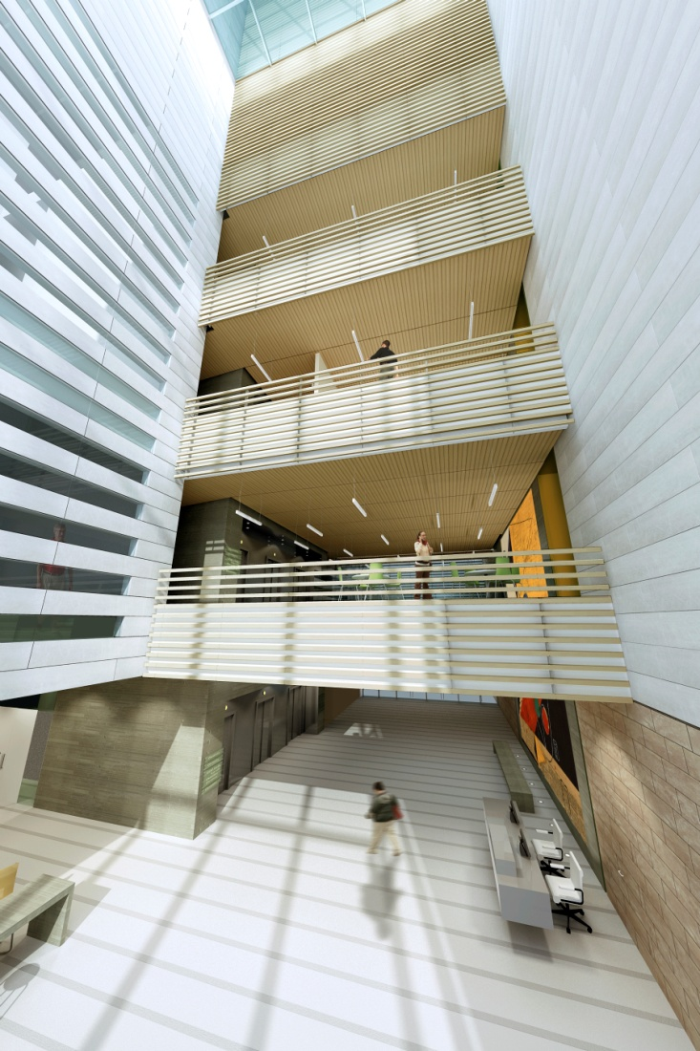
Keys to Success
Everybody Part of the Solution & Outcome
Culture of “How Can We…”
Consensus Building
Owner Driven IPD Process
Notes:
Shannon

Slide 21
Key Success Points
Select CM/GC, D/B Subs early in the project process
Use Lean process in design phase
Extend the incentive program to architects/engineers and every sub on the job, expand incentives in design phase
Focus on innovation and teamwork in Prequalification/Best Value selection
Exploit the Building Information Model to the fullest extent possible
Engage the imagination and commitment of all team members

Slide 22
11-Year Experience (ex-UCSF Hospital)

Slide 23
UC Development & Implementation
Implement Pilot Program for Integrated Project Delivery and Lean Construction (UCSF and 1 Other Campus).
Expanded Pilot Program for Best Value contractor selection UC-wide as a means of IPD/Lean team selection. (Successful Legislative initiative).
Integrate BIM into all aspects of project delivery (UCSF pioneered BIM Guidelines).
Further develop UC contract forms, craft appropriate incentives for inclusion in contracts.
Further develop Lean/IPD prequalification and Best Value selection processes and procedures.

Slide 24
UC Development & Implementation
Develop policy language around use of Lean, IPD, and incentives in UC contracts.
Resolve lingering insurance issues, especially errors and omissions insurance for integrated teams and design/build and design/assist delivery settings.
Training for Project Managers and UC Executives.
Develop unbiased, more detailed and segmented metrics and procedures for evaluating performance and success.

