Slide 1
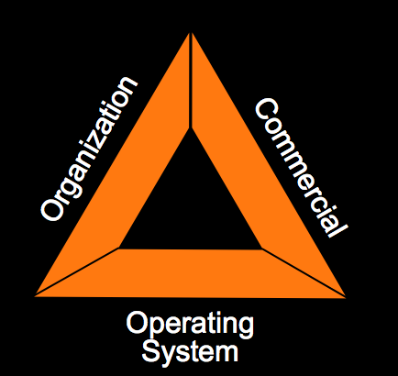
Structuring work for flow and value through collaborative planning
Gregory Howell
Lean Construction Institute

Slide 2
What is an Owner buying?
What is the nature of Projects?
What is the work in projects?
What sort of organization is appropriate?

Slide 3
What are Owners Buying?
An Owner must decide what they are buying: A completely defined product or the services of a team trying to solve a problem that no one completely understands and keeps changing.
Jim Carroll, 1989

Slide 4
What is the nature of projects
Simple
&
Certain
Complex
& Uncertain

Slide 5
Reducing Uncertainty: The work in projects
Certain about What
Uncertain about what & how
What to Build
Certain about How
Certain about what and how
How to Build

Slide 6
Traditional Procurement
Certain Objectives
Uncertain Means
Uncertain Objectives
Uncertain Means
1
5
10
10
Uncertainty about What to build
5
1
Certain Objectives
Certain Means
Uncertain Objectives
Certain Means
Uncertainty about How to Build

Slide 7
Ends & Means Uncertainty
Certain Objectives
Uncertain Means
Uncertain Objectives
Uncertain Means
1
5
10
10
✪
Uncertainty about What to build
5
1
Certain Objectives
Certain Means
Uncertain Objectives
Certain Means
Uncertainty about How to Build

Slide 8
Uncertainty on Typical Projects at Start of Construction 1990
Certain Objectives
Uncertain Means
Uncertain Objectives
Uncertain Means
1
5
10
10
Uncertainty about What to build
5
1
Certain Objectives
Certain Means
Uncertain Objectives
Certain Means
Uncertainty about How to Build

Slide 9
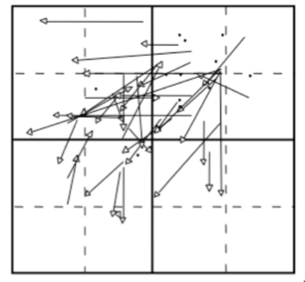
Uncertainty at Start of Construction on Most Recent Project - 1990
Certain Objectives
Uncertain Means
Uncertain Objectives
Uncertain Means
1
5
10
10
Uncertainty about What to build
5
1
Certain Objectives
Certain Means
Uncertain Objectives
Certain Means
Uncertainty about How to Build

Slide 10
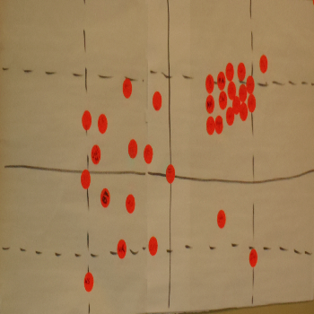
Uncertainty on Typical Building Projects At Start of Construction - 2011
Certain Objectives
Uncertain Means
Uncertain Objectives
Uncertain Means
1
5
10
Uncertainty about What to build
Certain Objectives
Certain Means
Uncertain Objectives
Certain Means
Uncertainty about How to Build

Slide 11
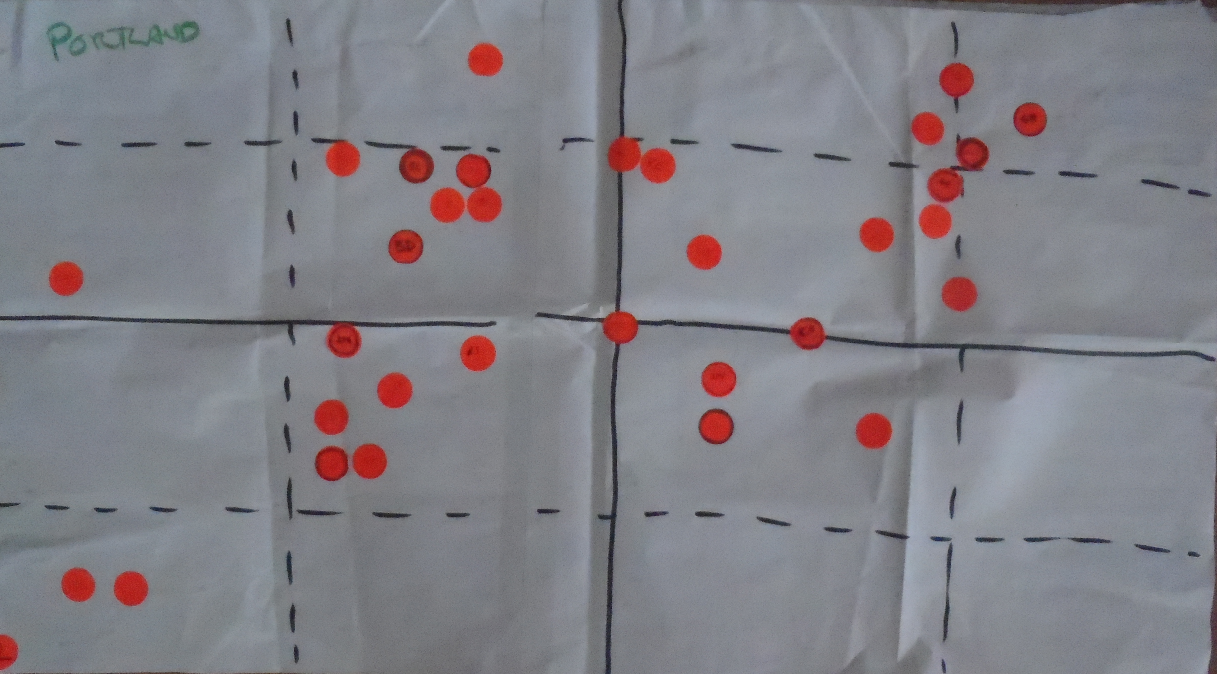
Uncertainty at Start of Construction on Typical
High Tech Projects - 2011
Certain Objectives
Uncertain Means
Uncertain Objectives
Uncertain Means
Uncertainty about What to build
Certain Objectives
Certain Means
Uncertainty about How to Build
Uncertain Objectives
Certain Means

Slide 12
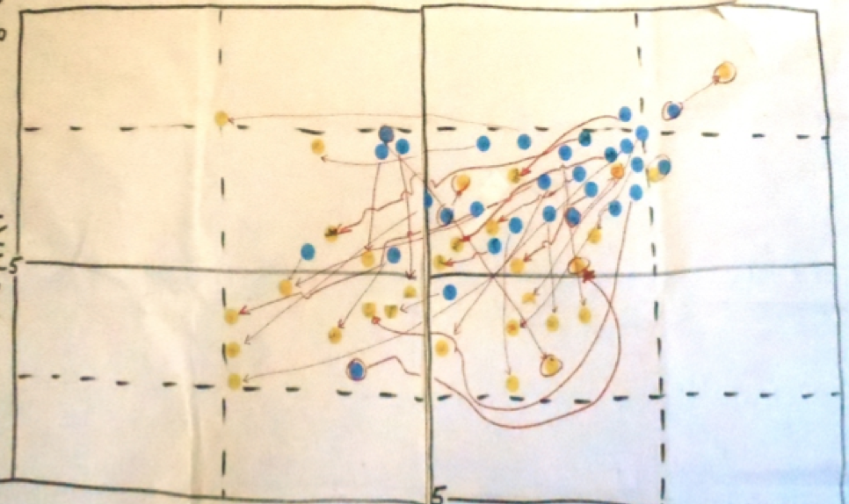
Ends & Means Uncertainty at Start of Construction on Most Recent Building Project 2011
Certain Objectives
Uncertain Means
Uncertain Objectives
Uncertain Means
Uncertainty about What to build
Certain Objectives
Certain Means
Uncertain Objectives
Certain Means
Uncertainty about How to Build

Slide 13
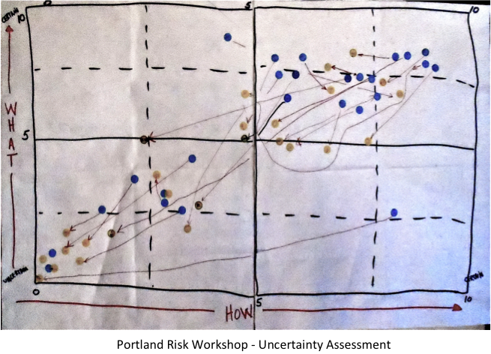
Uncertainty on Most Recent Project
High Tech - 2011
Certain Objectives
Uncertain Means
Uncertain Objectives
Uncertain Means
Uncertainty about What to build
Certain Objectives
Certain Means
Uncertain Objectives
Certain Means
Uncertainty about How to Build

Slide 14
Interdependent
Win - Ability to work together
Coaching - Communication, conversation and listening skills
Soccer
Basketball
Baseball
American Football
Independent
Winning – Statistical improbability
Planning – player selection
Coaching – Skills and situation response
American Football
Sequentially dependent
Win by making & following plan and …
Coaching in skill and individual response
Game Plans – Robert Keidel

Slide 15
Reducing Uncertainty: The work in projects
Certain about What
Uncertain about what & how
What to Build
Certain about How
Certain about what and how
How to Build

Slide 16
Managing in Uncertainty
Commanders intent – Focus on Purpose
Power to the Edge - Local Initiative
Willingness to share pains and gains: Honor
Rapid learning – What works where
Horizontal communication
Relationship of Senior to Junior: Scholar to Student
http://vimeo.com/45947817

