Slide 1

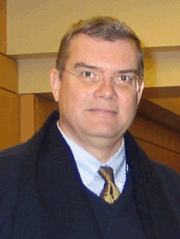
Seeing Both the Forest and the Trees:
Applying Lean Beyond Process Improvement to Organizational Structure
Presented by:
MICHAEL BADE
Assistant Vice Chancellor, Campus Architect | University of California, San Francisco
STEPHEN MACINTYRE
Lean Integration Leader | Haley & Aldrich

Slide 2

DESIRED OUTCOMES
Understand how Lean Principles support organization design
See how customers and staff can play a big role in organization design (and affect your results)
Understand how to use Lean process change for short-term gains while building an organization structure and staff capability for long-term results

Slide 3

AGENDA
Situation
  Where are we on our Lean Journey?
Lean & Organization Design
  Principles – how they fit
Current Situation & Gaps
  Customer and staff input
  Skills we have; skills we need
  Processes and their limitations
  Desired Outcomes
    What do we want to achieve?
  Our Plan

Slide 4
AGENDA
Your Situation
  Where are you on your Lean Journey?
Lean & Organization Design
  Principles – how they fit
Current Situation & Gaps
  Customer and staff input
  Skills we have; skills we need
  Processes and their limitations
  Desired Outcomes
    What do we want to achieve?
  Our Plan

Slide 5

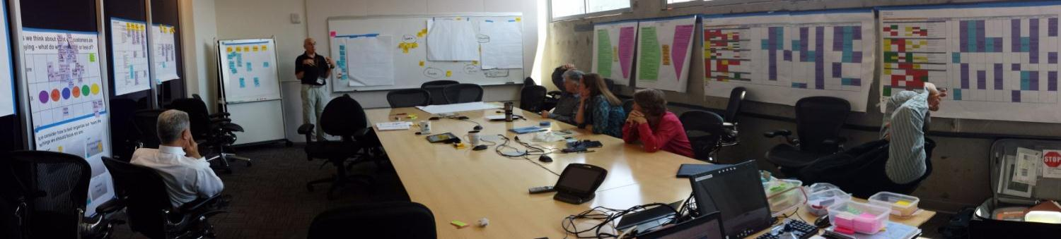
WHAT IS LEAN?
A system of thinking and acting which:
Increases Value
Reduces Waste
Respects People
Not an end in itself;
it’s a way of achieving the results.
Creates ability of people to adapt.
Notes:
At its essence Lean is a way of working and acting that is based on a set of principles and uses numerous tools to Increase Value to the Customer, Identify and Reduce Waste and Provide a Respectful Environment for People
You may have seen or heard us use this mnemonic device before. The VW logo is a great way to remember these tenets of Lean – V for Value, W for Waste and Who Knows how the last concept – respect for People is shown in the logo?

Slide 6
GETTING STARTED
On a Broader Lean Perspective
Misconceptions | Lean Perspectives
We don’t have enough people with the right skills | We have not made a strong effort to simplify, standardize and error-proof
Our customers don’t understand | We aren’t really solving customer problems
Employees are dedicated and valuable | Our processes help waste employee’s time & cause stress
We pay for strong, reliable performance | Poor performance is often hidden by heroics
We listen to our employees (but really listen to others) | Employees have answers that need to be unleashed
We continually create value | We’re all busy but only some of it really adds value
We know who the big problems are | Our systems are set up to give us exactly what we get

Slide 7
WHAT IS ORGANIZATION DESIGN?
Deliberate method to configure structures, processes, rewards, and people to create an effective organization capable of achieving strategy.
Not an end in itself; it’s a way of
achieving results.
Improves ability of
organization to
adapt.
VICE
CHANCELLOR
ASSISTANT
DIRECTOR 1
DIRECTOR 2
DIRECTOR 3
Notes:
As you can see – both have similar ends they seek
Both of these are often approached intuitively but we have systems and we’ll share a Lean framework for this with you today

Slide 8
LEAN SYSTEM HAS “4P” PRINCIPLES
EXPOSE &
SOLVE
PROBLEMS
Overarching “4P”
DEVELOP PEOPLE
& PARTNERS
RIGHT PROCESS RIGHT RESULTS
LONG TERM PHILOSOPHY
Notes:
In the Toyota Production system – there are 14 Principles. They fall under 4 main categories – 4P
PHILOSOPHY - The first principle is to foster a Long Term Philosophy - The Toyota Way Philosophy can be summarized as simply: Do the right thing for the company, it’s employees, the customers and society as a whole.
Focus on long-term philosophy – even at the expense of short term financial goals
Cost reduction has been a passion since Taiichi Ohno created the famous Toyota Production System on the shop floor. Yet cost reduction is not what drives Toyota – it’s value creation
PROCESS:
Lean looks at all of our work as a process and seeks to improve the way that process delivers value. Work together to figure out which are the right processes on which to focus. By working on the right process, we will deliver the right results. To do this:
Create a continuous process flow to bring problems to the surface
Use "pull" systems to avoid overproduction – keep small amounts around and replenish (supermarket).
Stabilize/Level the workload (work like the tortoise, not the hare) - Heijunka.
Build a culture of stopping to fix problems, to get quality right the first time – loom
Standardized tasks and processes are the foundation for continuous improvement and employee empowerment. They capture learning up until that point You cannot predict the timing and output of your processes unless standard.
Use visual control so no problems are hidden
Use only reliable, thoroughly tested technology that serves your people and process.
PEOPLE:
- Grow leaders who thoroughly understand the work, live the philosophy, and teach it to others. They will carry out that long term philosophy, to create and implement the best processes,
Toyota believes that investing in and developing people and partners will work best to deliver value to customers and stakeholders.
Develop exceptional people and teams who follow your company's philosophy.
Respect your extended network of partners and suppliers by challenging them and helping them improve.
Develop leaders – grow from within. Be a LEARNING organization
Develop workers/team work
Develop suppliers/partnerships
PROBLEMS
Finally the lean way of thinking treats problems as gold.
These are all the things that get in the way of us doing the things we’ve set out do.
This is really the first step to any improvement – you really need to see problems(s).
We want to deeply understand why they exist and seek to eliminate their CAUSES.
We need to go where the work is actually done (gemba) and see if for ourselves (genchi genbutsu)
If we make problems visible – maybe people will be dissatisfied.
If they are dissatisfied, they will improve or change processes to get rid of those problems.
If they get rid of them, they will be able to deliver the value needed by customers and communities.

Slide 9
OVERARCHING LEAN PRNCIPLES – 4P
Many Lean efforts
focus on process “waste”.
This works but can be tough to make stick without constant involvement of lean practitioners or management.
EXPOSE &
SOLVE
PROBLEMS
Overarching “4P”
DEVELOP PEOPLE
& PARTNERS
RIGHT PROCESS RIGHT RESULTS
LONG TERM PHILOSOPHY
Notes:
Many Lean Programs Focus Only On Process BUT without strategy/philosophy the right results aren’t clear, without people & partners processes can’t be developed or operated, without problems and ways s to solve them things will revert to the old ways

Slide 10
ORGANIZATION DESIGN
Deals with Similar Considerations
VICE
CHANCELLOR
ASSISTANT
DIRECTOR 1
DIRECTOR 2
DIRECTOR 3
Many organization design efforts
focus on structure.
This can be tough to make work without the right people, processes and strategy
STRUCTURE
PEOPLE CAPABILITIES
& REWARDS
MANAGEMENT & WORK PROCESSES
STRATEGY CONNECTED TO CUSTOMER NEEDS

Slide 11
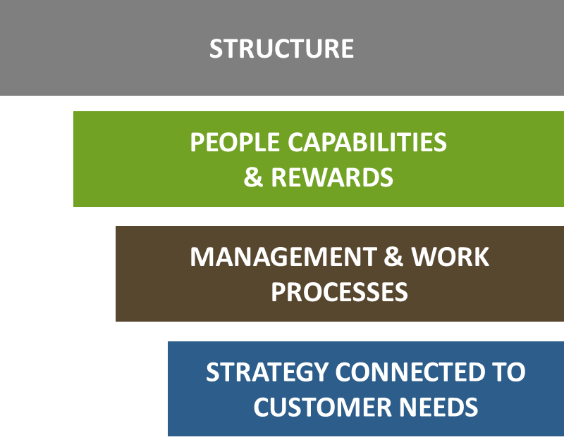
According to Susan Mohrman & others at USC’s Center for Effective Organizations
High performing organizations support strategy with:
Structure for performance & decisions
Clear responsibilities & decision-making
Skills & knowledge to operate without
day-to-day high-level management control
Integration with interdependent units
Whole work processes that deliver value to the customer
Measuring, responding to and learning from process & results
Continually improving

Slide 12
APPLY PRINCIPLES TO ORGANIZATION:
STRATEGY & CUSTOMERS
Assess customer needs, get honest feedback on performance. Build this into strategy.
PEOPLE & PARTNERS
Understand and match people’s drives and skills with customers and processes.
STRUCTURE & MGMT PROCESS
Identify how structure can help or impede what you need to achieve. Measure, implement, check with customers.
PROCESS
Find out which processes are causing problems and work on them for your customers.
(Measure)
Notes:
You’re accustomed to applying Lean thinking and tools to:
Consider what you’re trying to achieve
Assess Current Situation
Set the Future State / Target Conditions
Identify Problems, Obstacles, Causes
Design Countermeasures
Test, Implement
Measure
Adjust/Standardize, Do Again
The big difference?
Strategy, People & Structure Improvements Together

Slide 13
AGENDA
Your Situation
  Where are we on our Lean Journey?
Lean & Organization Design
  Principles – how they fit
Current Situation & Gaps
  Customer and staff input
  Skills we have; skills we need
  Processes and their limitations
  Desired Outcomes
  What do we want to achieve?
  Our Plan

Slide 14
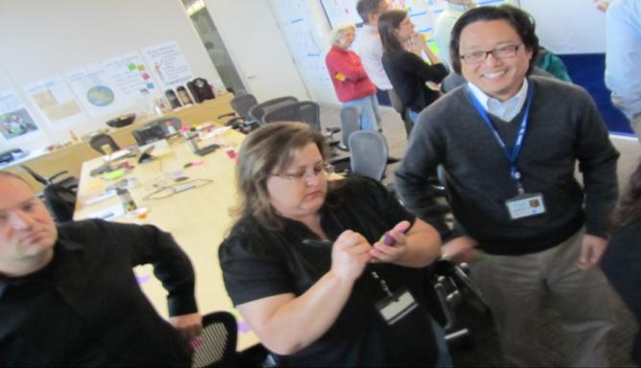
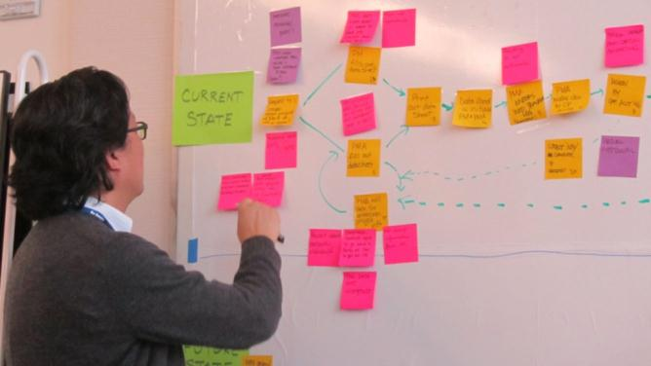
CP PURPOSE
Create a healthier workplace to get more done with less stress
Improve Capital
Project Processes
Assess and Refine
Organizational Structure
Lower the cost and improve timeliness of project delivery
Strategically reorganize project delivery processes
Identify skill sets, roles, responsibilities, and span of control for Capital Programs leadership and governance

Slide 15
CURRENT SITUATION SUMMARY
Customers satisfied with staff & projects
Directors and staff go the extra distance
Customers experience inconsistency & higher cost
CP staff are stressed by complex processes

Slide 16
CUSTOMERS: CURRENT STATE
PAIN (H High, M Medium, L Low) (10 min.) |  |  |  |  |  |  | CP Accountability & Responsibility | PAIN (H High, M Medium, L Low) (10 min.)
Diabetes |  | Pharmacy | FAS/Sr. VC/Finance | Education/ OM Med Education | Med- Adm. Research | SFGH |  | ITS |  | Deans Office | HDF CCC | Finance SC | Facilities Mngmt. | Budget & Resources
 |  |  |  |  |  |  | 1. Project Initiation
 |  |  |  |  |  |  | Workload Allocation
 |  |  |  |  |  |  | Project Delivery Strategy
 |  |  |  |  |  |  | Project Initiation | Project Launch |  |  |  |  | Need to be included in MEP basis of design & budget
 |  |  |  |  |  |  | Project Forecasting | Project Launch
 |  |  |  |  |  |  | Budget Development |  |  |  |  |  | Need to be included in MEP basis of design & budget
 |  |  |  |  |  |  | Funding Request
 |  |  |  |  |  |  | Risk Management Reporting
 |  |  |  |  |  |  | 2. Design
 |  |  |  |  |  |  | Professional Services Department | Technology Selection |  |  | Insufficient stakeholder input into V.E. decisions
 |  |  |  |  |  |  | Budget Worksheet Development
 |  |  |  |  |  |  | Additional Funding Request
 |  |  |  |  |  |  | Design Review & Permitting |  |  |  |  |  | Need to stay in communication on design changes at each phase of design development
 |  |  |  |  |  |  | Capital Project Approval
 |  |  |  |  |  |  | Payment Management
 |  |  |  |  |  |  | 3. Construction
 |  |  |  |  |  |  | Contractor Selection
 |  |  |  |  |  |  | Invitation to Bid
 |  |  |  |  |  |  | Prequal. 1st & 2nd Stages
 |  |  |  |  |  |  | Change Management |  |  |  | Numerous delays in project prior to start of construction |  | Need to review change orders & submittals
 |  |  |  |  |  |  | Construction Oversight
 |  |  |  |  |  |  | Reporting
 |  |  |  |  |  |  | 4. Occupancy Mgmt..
 |  |  | timing expectation communication |  | Training | Training |  | Support for remaining issues |  |  | Post occupancy issues slow or incompletely resolved | State Fire Marshall | Need smoother turnover, warranty mgmt. punch list completion
 |  |  |  | Technology Handoffs
 |  |  |  |  |  |  | 5. Project Closeout
 |  |  |  |  |  |  | Request for Notice of Completion & Final Closeout | Punch List |  |  |  |  | PM often moves on to next project before all issues with current project are resolved
 |  |  |  |  |  |  | Archives |  |  | Time
 |  |  |  |  |  |  | Financial Closeout |  |  | Time
 |  |  |  |  |  |  | 6. Capital Planning Process Support
Lots of Pain
Strengths
Lots of Pain

Slide 17
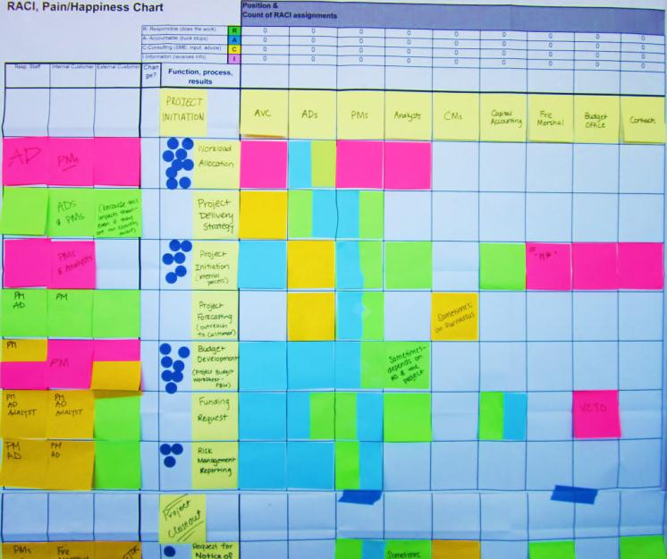
STAFF “PAIN” RESULTED FROM PROCESS, PERSONALITY, STRUCTURE
Workload Allocation
"Project Initiation"
Professional Services
Procurement
Design Review & Permitting
Capital Project Approval
Contractor Selection
Change Management
Reporting
Occupancy Management
Archiving

Slide 18
THINGS WORKING WELL
Customers
Excellent architects & designers. Several strong PMs and analysts.
Many great projects provide the desired outcomes
Timely, transparent communications
Construction is well managed
Staff & Directors
Strong knowledge on team, always someone who can help
Able to conceptualize and complete complex projects.
Everyone chips in – staff get along well
Highly skilled analysts provide good PM support

Slide 19
THINGS WE NEED TO IMPROVE
Customers
Inconsistent quality by PMs
Close out 2+ yrs & hold funds
Too much waiting
Too costly, unrealistic budgets
CP is understaffed
Staff & Directors
Lack consistency in PM methodologies
Many processes “get in the way” e.g. closeout
Approval bottlenecks
Complex processes used for both small & large projects adds cost
Staff absorb hours to get job done

Slide 20
PRIMARY CAUSES OF CURRENT CONDITION
STRATEGY & CUSTOMERS
Need better ways to “hear” & quickly respond to customers
Metrics are lagging & difficult to respond to
PEOPLE & REWARDS
Mix of staff capabilities & management drives could be improved
STRUCTURE & MANAGEMENT PROCESS
Lack role & responsibility clarity
CP mgmt. structure gaps (inconsistency & decision-making speed)
AVC/Campus Architect overburden
WORK PROCESS
Not standardized
Complexity & approvals consume time and budget
Lack an effective business system
Notes:
You’re accustomed to applying Lean thinking and tools to:
Consider what you’re trying to achieve
Assess Current Situation
Set the Future State / Target Conditions
Identify Problems, Obstacles, Causes
Design Countermeasures
Test, Implement
Measure
Adjust/Standardize, Do Again
The big difference?
Strategy, People & Structure Improvements Together

Slide 21
WHAT STEPS ARE WE TAKING?
STRATEGY & CUSTOMERS
CPAG (Customer) feedback session
Connect Pain & Positive Performance to Processes
Ask customers which structure options they prefer
PEOPLE & PARTNERS
PI & Mgt Drives Evaluation
Assess process needs
Staff capabilities assessment
Match staff makeup gaps with process & customer needs
STRUCTURE & MGMT PROCESS
Define Org Design Criteria to fill people, process and customer gaps
Look at process, people problems
Identify & evaluate structure options
Customer input
PROCESS
Training
Assess Customers & Value
Test Process vs. Value & Staff experience using RACI/ Pain chart
Kaizen and VSM
Notes:
Drives are the filter between ability and action, between competence and behavior
Drive patterns are predictive for behavior, of individuals and groups
Drives can be used to understand organizational aspects such as cooperation, management and performance
You’re accustomed to applying Lean thinking and tools to:
Consider what you’re trying to achieve
Assess Current Situation
Set the Future State / Target Conditions
Identify Problems, Obstacles, Causes
Design Countermeasures
Test, Implement
Measure
Adjust/Standardize, Do Again
The big difference?
Strategy, People & Structure Improvements Together

Slide 22
CUSTOMER “PAIN” & STAFF
PERSONALITY DRIVES MATCHED!
Strengths
Communication & Consultation
Big Picture Thinking/Strategy
Achieving Cost-Effective Results
Clear Structure
& Standard Procedures
Mutual Trust
Speed & Decisiveness
Gaps

Slide 23
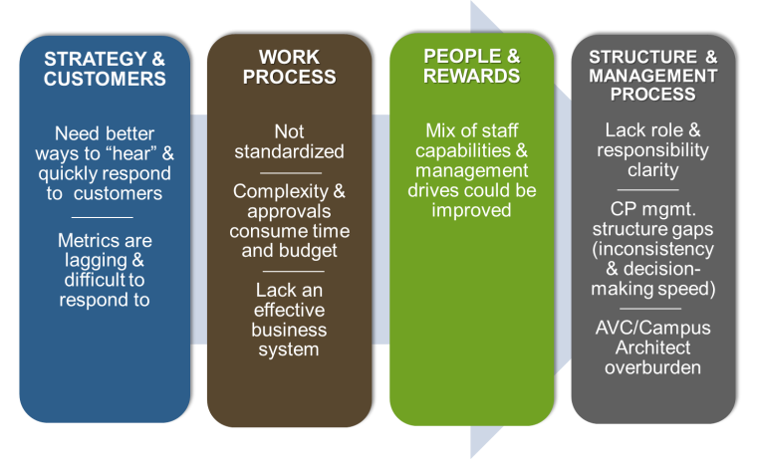
WHAT DOES THIS MEAN FOR ACTIONS?
Causes Helped Specify Org Design Criteria
Understanding customer needs and relationships provides design basis for processes
Better work processes will enable staff to be more effective, projects more cost-effective
People with the right skills
will develop/implement
better processes
Structure can speed up
decisions, processes, resolve
problems and distribute work

Slide 24
SUMMARY OF KEY ACTIONS
Process, Capabilities, Structure Will Improve Together
Action | 2013 Apr-Jun | 2013 Jul-Sep | 2013 Oct-Dec | 2014 Jan-Mar | 2013-2014 Apr-Jun | 2014-5
WORK & MANAGEMENT PROCESSES
Prioritize & develop A3 plan
Process improvement, metrics & business system
STRUCTURE & CAPACITY
Revisit structure & fill open roles
Re-define AD Role – customer/project facing
Work with other departments to delineate roles
PEOPLE & SKILLS
PM Skill Improvement
Continual Improvement Skills

Slide 25
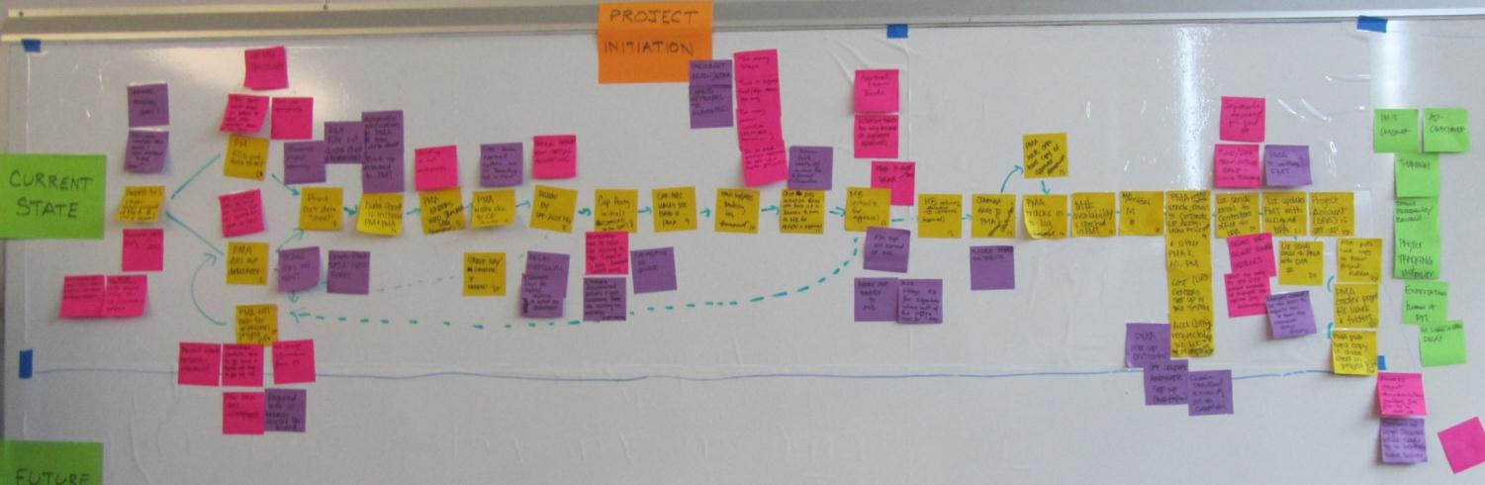
Understanding Current State:
CP Project Initiation
26 Steps

Slide 26
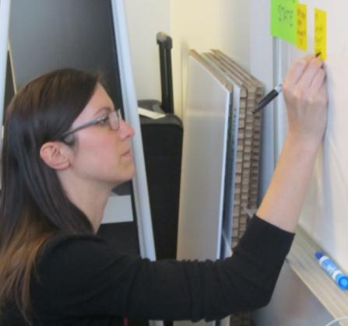
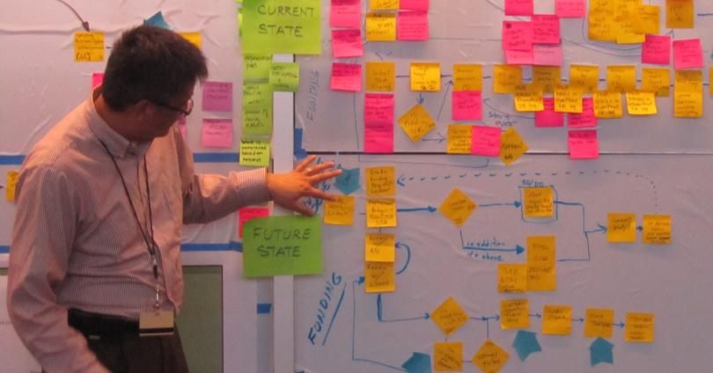
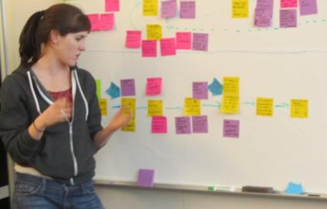
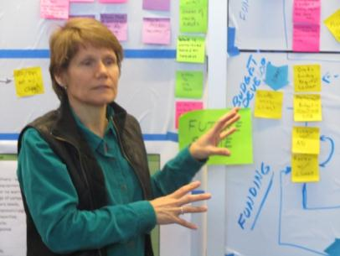
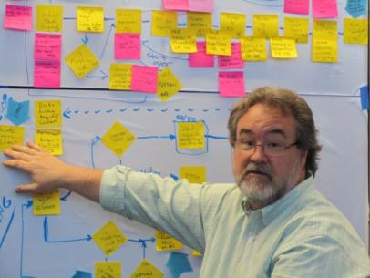
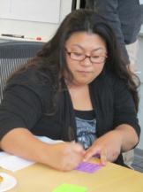
Developing Desired Future State Value Stream Map

Slide 27
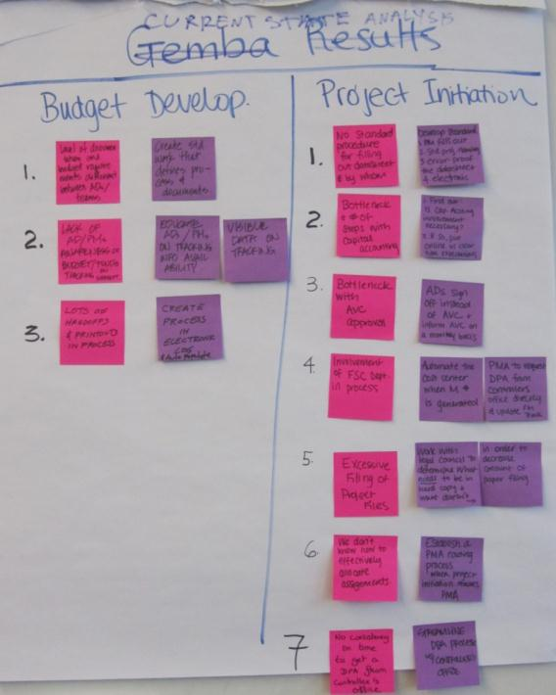
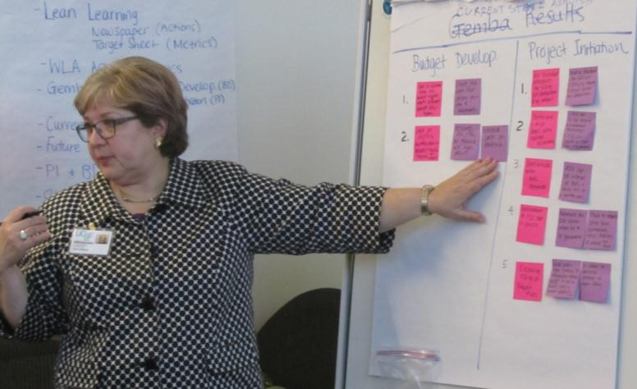
Identifying Major Problems &
Possible Countermeasures

Slide 28
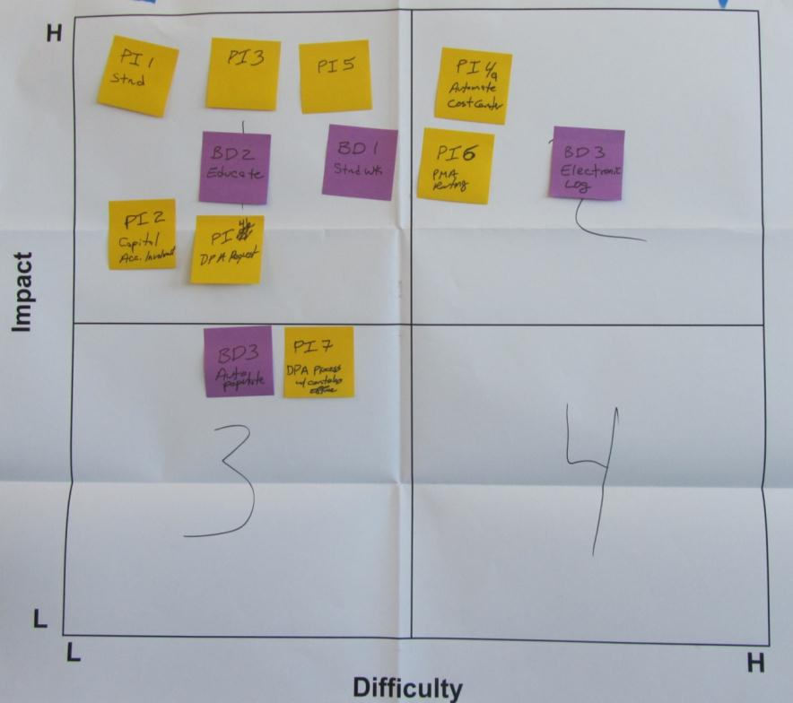
Assessing Countermeasure Ideas
Start here with the High Impact and Low Difficulty Ideas!

Slide 29
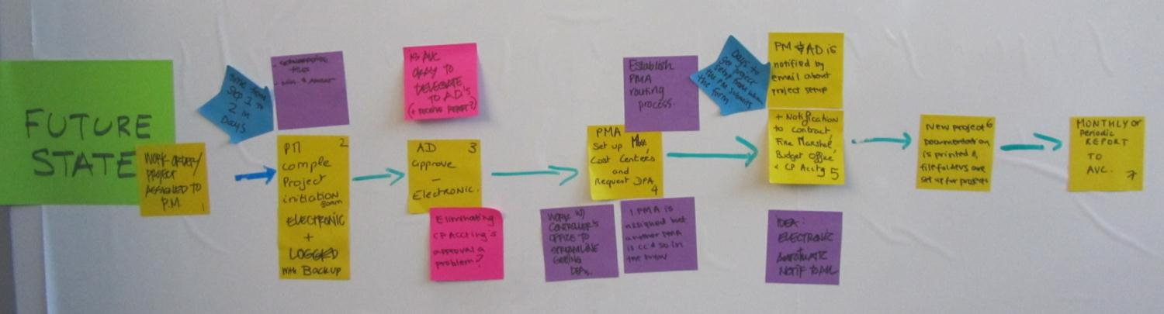
Finalizing a Future State
7 Steps

Slide 30
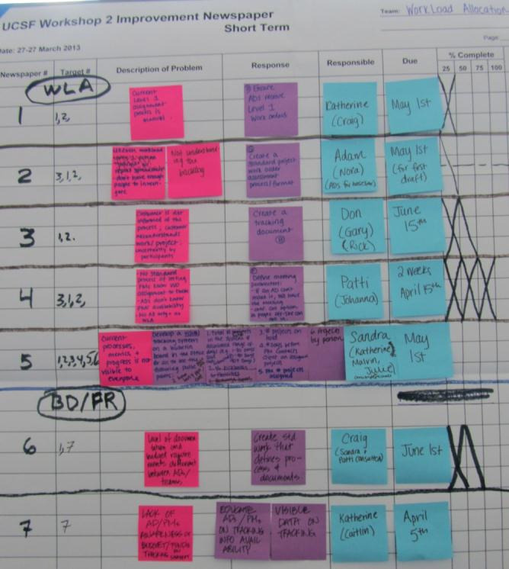
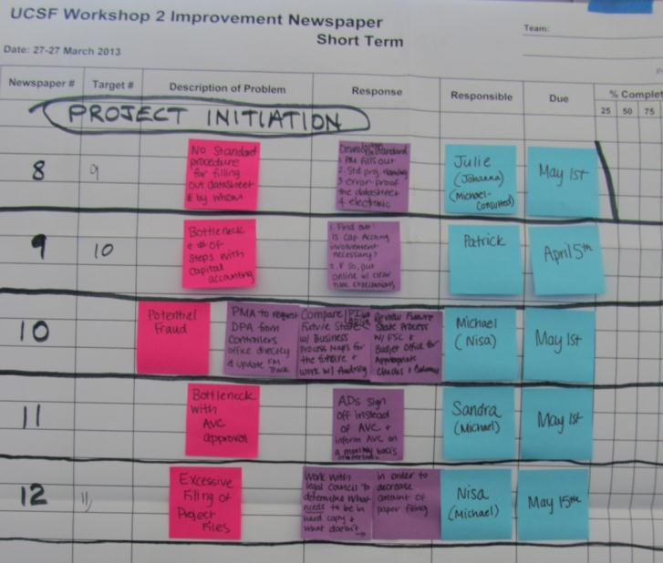
Developing an Action Plan
And tied Actions to Metrics

Slide 31
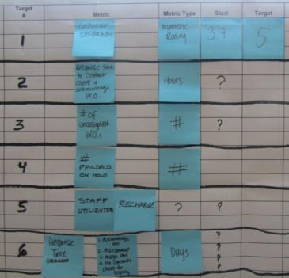
Creating metrics and Checks
Target # | Metric | Type | Start | Target
1 | Customer Satisfaction | # | 3.7 | 5
2 | Unassigned WOs | # | TBD | TBD
3 | Staff Utilization (Recharge) | Hours | TBD | TBD
4 | Response Time in WLA: Acknowledge WO Assessment complete Assign PM PM contacts client for scoping | Days | TBD | TBD
5 | Iterations (rework) of a budget for AD approval | # | TBD | TBD
6 | # Days from when WO is assigned to PM to when PM submits datasheet in Project Initiation Process | Days
7 | Steps in Project Initiation Process | # | 26 | 7
8 | Days to complete Project Initiation | Days | TBD | TBD

Slide 32
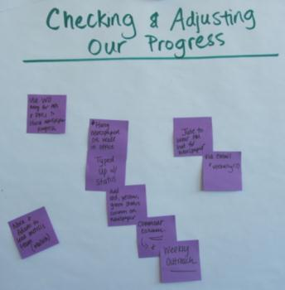
Agree on Check & Adjust Process
Nora and Adam (with support from Malvin) will lead Metrics team to track and report out identified metrics
Julie to serve as a PM for the Newspaper and contact each “lead” for each action item via email or verbally on a weekly basis to help keep processes moving forward
Hang Improvement Newspaper on the wall in the office to keep it visible and show progress

Slide 33
Small Projects Initiative
Small projects are weighted down with costs and the same process steps in letting contracts as large projects
On the other hand, customers want speedy implementation, low cost, and low disruption of their operations
Small projects use small contractors who cannot invest in process improvements like larger contractors can
Most projects are small – UCSF typically has ~200 projects ongoing, of which all but a handful are small
Dollar volume of small projects can reach $100M annually

Slide 34
Strategies
Use Best Value contractor selection to identify high-capability, high-quality contractors
Redesign small projects implementation process – use Job Order Contracting (JOC) to batch small projects into larger batches
Use Best Value to select contractors for medium-sized projects using Design-Bid-Build delivery
Create standardized work processes internally to allow process benchmarking
Focus improvement program on customer value

Slide 35
Small Projects Process Improvements
Batching small projects gives scale which allows use of Lean construction tools such as Last Planner, Pull Scheduling
Design of small projects system can allow pairing of design and construction firms into a virtual design-build team
Duration of JOC contract allows contractor to work with UCSF to improve project logistics and support services (from Facilities Management and other units)
More to come!

Slide 36
LEAN APPROACH GAVE US A PLAN:
Improve Each Element For Higher Performance
Strategy: continual PDCA of customer needs, transparency, new business system, define department roles
Work & Management Processes: systematically streamline, improve delivery models, support with business system
People: Hire to fill the gaps in capabilities & drives, improve capacity with process change
Structure: Reshape reporting relationships
Notes:
Facilitated by consultant but developed by those who know the work and results best: Customers and employees who do the work
Several changes; most within 2 areas of focus:
Standardize and streamline key processes to improve results and unveil hidden resources
Fill gaps in work needs with hires that can augment cultural and operational needs of CP

Slide 37
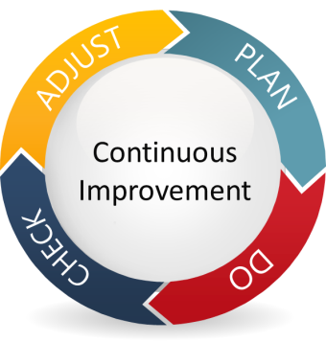
A Few Lessons Learned
Start with a shared understanding of the goals, current situation and problems; if you don’t focus on what is most important you might improve the wrong things
Get the right people involved – include policy and decision makers, staff, customers, suppliers - challenge all of them and help them improve. Select an implementation leader.
Trust people doing the work to understand WAH (What Actually Happens) and to develop solutions; look
for waste AND for positive deviants
Match structure to processes to resources
to customer needs to strategy
Engage people to understand the big picture;
they will develop ownership for long term success
Notes:
Task 1 (Check) Timeline 4 weeks total – weeks 8-12
Identify risks with greatest likelihood of causing problems
The assessment focuses on environmental risks from facility operations, the resources to address /mitigate risks, and identifying best practices that may be useful across the organization.
Consistent content will be utilized to assure comparable results
Electronic checklist tool will be utilized by team members
Insert screen shot or other for the electronic data capture during assessment
The assessment focuses on environmental risks from facility operations, the resources to address /mitigate risks, and identifying best practices that may be useful across the organization.
Consistent content will be utilized to assure comparable results
Electronic checklist tool will be utilized by team members
Resources here means programs, staff, procedures

Slide 38

REFLECTION
Questions
Plus/Delta
Notes:
KELLY
(Make sure everyone applauds the fishbowl participants – thank them.)
(Stay in a circle, make room for other 3 to join circle)
In the last few minutes let’s just have an informal dialogue – if anyone has any reflections about today, open questions, learnings, this is an opportunity to share with each other and you can continue over cocktail hour. (Kate capture on flipchart)
What we’ve done today is try to equip you with some lean thinking and tools. Lean is all about understanding value, making waste visible in order to reduce it, and respecting employees in the process. It’s also about building on what you learn. Practicing lean on a daily basis is something anyone can do, however to really commit to integrating it in your culture I’d point you to some resources we have at the back of the room – these are simply suggestions for books, articles, and of course our contact info if you’d like to take more of a lean journey with an advisor. Thank you for your participation today!

