Slide 1
Introduction to Lean Construction
Lean Construction Institute
Glenn Ballard, PhD
Gregory Howell, P.E.

Slide 2
Workshop Objectives
Understand Lean Project Delivery
  Fundamental concepts, principles, key practices & basic vocabulary
  How Lean Construction differs from current practice
3 Opportunities
  Opportunity: Impeccable Coordination
  Opportunity: Organizing the project as a production system
  Opportunity: The Project as a Collective Enterprise
Decide next steps

Slide 3
Putting the pieces together
Organization
Commercial Terms
Project
Delivery
Operating System
3

Slide 4
Lean in the Construction Industry:
Three Connected Opportunities
IMPECCABLE COORDINATION
ORGANIZING PROJECTS AS PRODUCTION SYSTEMS
THE PROJECT AS A COLLECTIVE ENTERPRISE
© Lean Construction Institute, 2009

Slide 5
Parade of Trades Assumptions
The project has 35 units of work to be processed.
There are seven trades, each of which must process all 35 units of work in order for the project to complete.
The trades come onto the project a week apart.
The trades work in sequence, with each following trade able to work only on what was produced in the previous week by the prior trade.
Work is done by rolling a dye (singular of ‘dice’) and passing the number of units rolled—up to the number of units the trade has to work on.
The number rolled represents the number of workers brought to the site that week by the trade rolling the dye. Each worker is able to process one unit of work in the week.

Slide 6
Parade of Trades
Move 35 pieces of work through 7 trades.
Work is completed at the end of the week and passed to next trade. Place materials on table as shown.
Legos & Score Sheet
Dice
Concrete
Paint
Mason
Electrical
Facade
Plumber
Carpenter
6

Slide 7
Distribute score sheets as directed
Chips to the left of Concrete
Establish queue spaces
Give die to Painter
Mason
Facade
Chips
Concrete
35
Carpenter
Paint
Plumber
Electrical
Dice
7
Notes:
Orient to score sheet. 35 chips at 3.5 per week. Play in weeks. Note blank on score sheet because no work done until chips arrive.

Slide 8
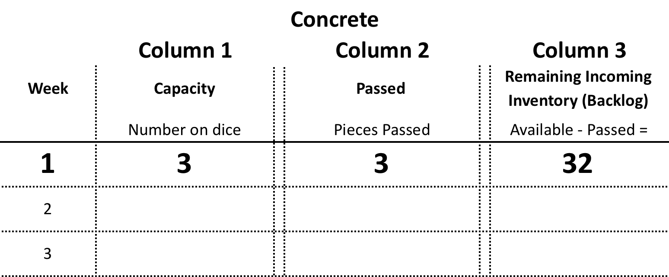
Week 1
Concrete
Pass the Die to the Left!
8

Slide 9
1
Mason
Facade
2
Chips
Concrete
35
Carpenter
Paint
Plumber
Electrical
Dice
9
Notes:
Start the second week.

Slide 10
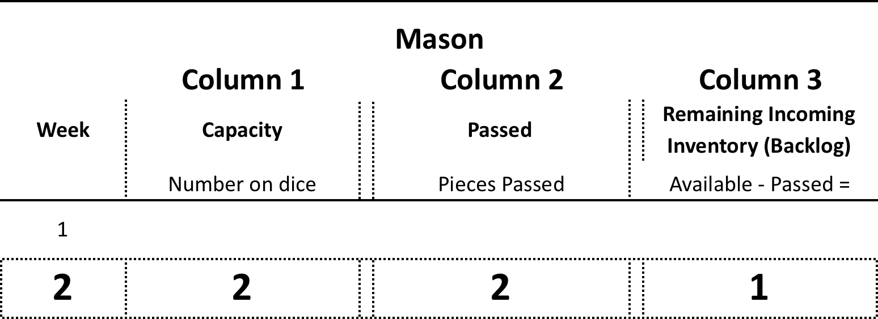
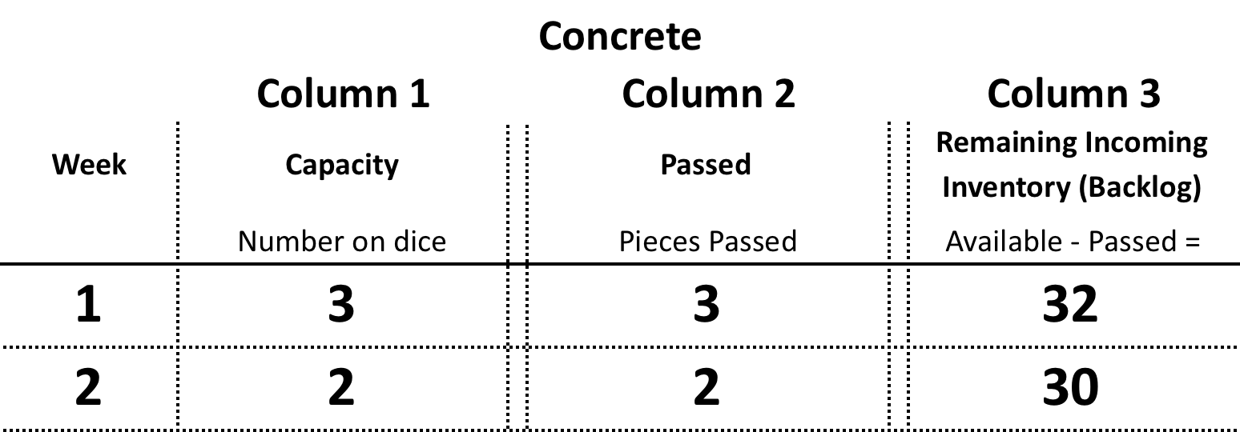
Week 2
Mason
3
Pass the Die to the Left!
Concrete
Pass the Die to the Left!
10

Slide 11
2
Mason
1
Facade
3
Chips
Concrete
35
Carpenter
Paint
Plumber
Electrical
Dice
11

Slide 12
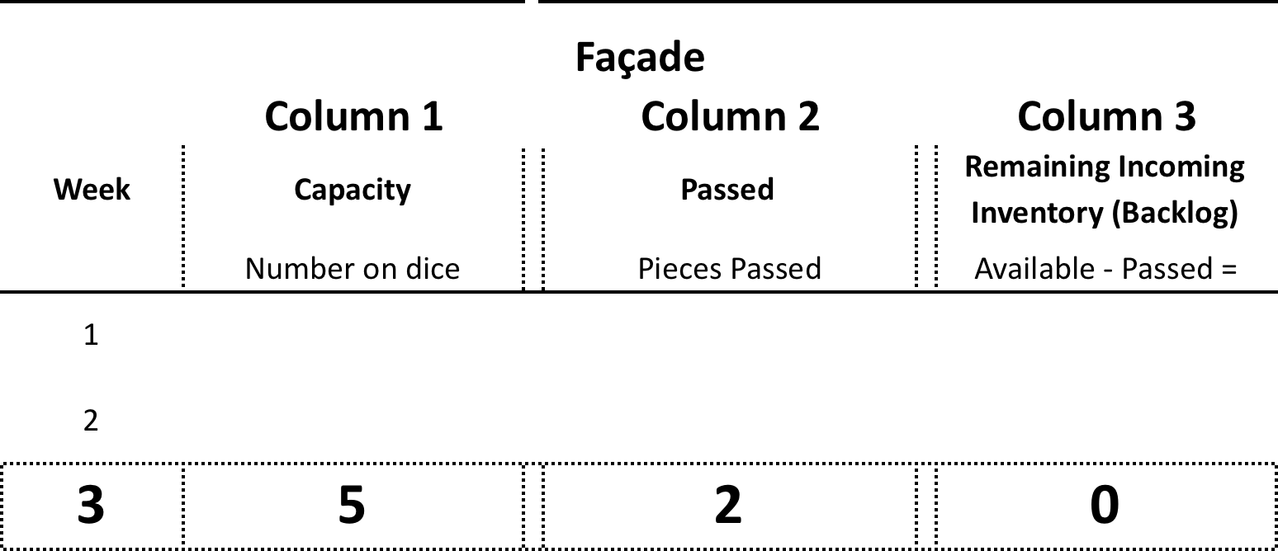
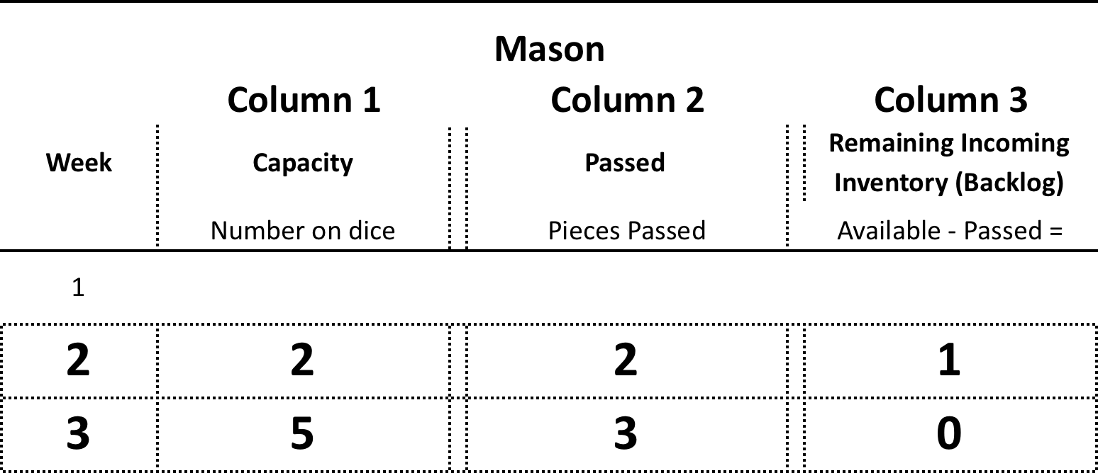
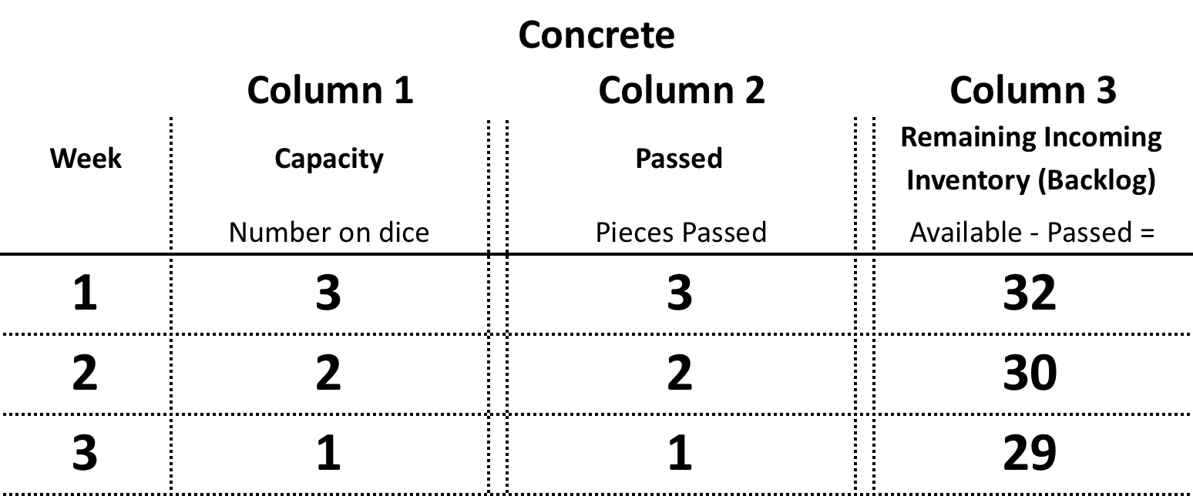
Facade
2
Mason
3
Concrete
30
12

Slide 13
Keep passing the die to the left!
Mason
Facade
Chips
Concrete
35
Carpenter
Paint
Plumber
Electrical
Dice
13
Keep passing the die to the left!

Slide 14
Scheduling and Estimating
Moving one chip through one station requires 1 “crew” work unit costing $1000. How much will it cost to complete the project?
A die has an average production of 3.5 units per roll (week). How long will it take?
14

Slide 15
When work is complete….
Record the week each Trade finishes. Sum and record the Available Capacity for all Trades. Sum and record the total Remaining Inventory for all Trades except Concrete. Note the highest amount of Inventory in any week for each trade. Bring die and score sheet to the front.
Craft | Week Complete | Total Capacity (Sum "Column 1") | Total Inventory (Column 3) | Highest inventory in any week for this trade
Concrete
Mason
Façade
Carpenter
Plumber
Electrical
Paint
Sum of Column
Circle Color Dice Numbers |  | Blue | Black | Red
15

Slide 16
RESULTS
# Weeks to Complete
# Weeks to Complete
Worst
Average
Best
1.1.1.6.6.6
1.2.2.5.5.6
1.2.3.4.5.6
2.2.3.4.5.5
2.3.3.4.4.5
3.3.3.4.4.4
16

Slide 17
20 Most Recent
 | Red 233445 | Black 123456 | Blue 122556 | 333333
Duration Weeks | 19 | 21 | 23 | 18
Total Capacity $ | 294 | 332 | 361 | 252
Inventory Units | 55 | 112 | 120 | 0
17

Slide 18

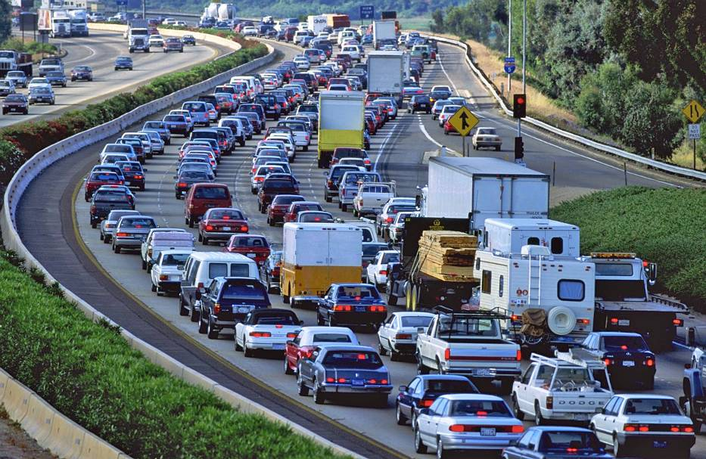
High Variability and Load on Resources (cars on the road) increases the travel (Cycle) time.
The gains are lost &
the losses mount up
Rush hour
5pm
Cycle Time
2am
Load on Resources
100%
18
Notes:
If we can reduce work flow variation between crews
Trades can follow closer and remain productive – the don’t need more time.
Don’t need to increase cost to gain timeWorkflow losses are real, lead to adversarial relations and not can not be demonstrated by delay claims, so…
Subs protect themselves by adding contingency and holding back labor to keep utilization high.
This further reduces workflow predictability and increases project risk.
By their/our actions, we shift that risk along.

Slide 19
Key Points
Reducing workflow variability
  Improves total system performance
  Makes project outcomes more predictable
  Simplifies coordination
  Reveals new opportunities for improvement
Point speed and productivity of a single operation doesn’t matter – throughput does.
Strategy: Reduce variation then go for speed to increase throughput.
Notes:
Workflow losses are real, lead to adversarial relations and not can not be demonstrated by delay claims, so…
Subs protect themselves by adding contingency and holding back labor to keep utilization high.
This further reduces workflow predictability and increases project risk.
By their/our actions, we shift that risk along.

Slide 20
Problems with current practice
Activity Focus ignores value creation and the flow of work.
  Collaboration in design is limited
  Fails to produce predictable work flow
Command and Control planning cannot coordinate the arrival of the wherewithal or work of specialists.
  Opportunities for trading ponies for horses are lost
  Push systems are commitment free zones.
Control begins with tracking cost and schedule.
  Efforts to improve productivity leads to Unreliable Work Flow further reducing project performance.
  Protecting activities leads to adversarial relations.

Slide 21
Question for Discussion
What would be the specific advantages of improved work flow reliability on your projects? For 10 minutes, discuss in 4 person teams. Select a spokesperson to report your findings if called upon.

Slide 22
Research Findings from early 1990’s
Contractor 1 33 %
Contractor 2 52 %
Contractor 3 61 %
Contractor 4 70 %
Contractor 5 64 %
Contractor 6 57 %
Contractor 7 45 %
Average 54 %

Slide 23
Why Last Planner®?
Without Last Planner®:
  only half the tasks on weekly work plans are completed as planned.
  so called ‘project control’ is after-the-fact identification of variances, not proactive steering toward objectives.
  projects are a commitment-free zone; promises are neither requested nor made.
  (If you can’t say ‘no’, you can’t make a promise.)
Notes:
Why Last Planner?
Without it, studies have found that only about half the tasks on work plans made as little as one week in advance are completed as planned. Since members of the project team are highly dependent on one another for doing their work, this robs everyone of the ability to plan and prepare.
‘Project control’ has traditionally involved measuring what DID happen against what SHOULD happen, then acting on negative differences between them. This is like trying to drive a car while looking in the rear view mirror.
Successful projects run on promises—in fact, that is true for all human cooperation. If you can’t say ‘no’, you can’t make a promise. On projects managed without the Last Planner philosophy, you can’t say ‘no’. Promises are neither requested nor made. This is a key reason for the 50% completion percentage.

Slide 24
Last Planner Principles
Starting Point: All plans are forecasts and all forecasts are wrong. The longer the forecast, the more wrong it is. The more detailed the forecast, the more wrong it is.
Plan in greater detail as you get closer to doing the work.
Produce plans collaboratively with those who will do the work.
Reveal and remove constraints on planned tasks as a team.
Make reliable promises.
Learn from breakdowns.
Notes:
Another reason for using the Last Planner approach lies in the facts about decision making in conditions of uncertainty; namely: All plans are forecasts and all forecasts are, by definition, wrong. No one can see into the future. The longer the forecast extends into the future, the more wrong it is. The greater the level of detail in the forecast, the more wrong it is.
These principles are the ‘design criteria’ for the Last Planner system.
“Plan in greater detail as you get closer to doing the work.” This is a response to the facts about forecasting and uncertainty.
“Produce plans collaboratively.” Planning is 90% social and 10% technical. The best plan is the one agreed by those responsible for execution. Collaborative planning produces better plans, better understanding of plans, and greater flexibility in changing plans should that be needed.
“Reveal and remove constraints on planned tasks as a team”. This is a consequence of the interdependence of team members one on another. Tasks have many constraints, and usually many different team members have control over those constraints.
“Make reliable promises”. Normal people take their promises seriously. That is the basis of social cooperation. Projects are temporary societies that must bring promising into play to enable working together effectively.
“Learn from breakdowns”. Despite best efforts, some promises will be broken. These breakdowns should be taken as opportunities for learning. Act on root causes to prevent reoccurrence. Being perfect planners is impossible. Not making the same mistake twice is only very difficult.

Slide 25
Last Planner®:
Predictable workflow & rapid learning.
Planning as Learning, Organizing and Promising
Conversation centered: The right people talk about the right thing at the right level of detail at the right time.
  Connects the big picture to details in progressively greater detail
Runs on and improves Confidence and Judgment
  Planning system performance metric
  Increase trust, reduce contingency
Designs and activates the Network of Commitments necessary to deliver project.
Notes:
The person or team that gives assignments (makes requests for commitments) to production units such as the squad leader for a design squad or the foreman for construction crews.

Slide 26
The “Physics” of Business and Coordination
Request Offer
“Will you?” “Would you like?”
1
Inquiry
Negotiation
Accepted
PO
Submitted
Clarification
&
Negotiation
Preparation
Signed
CUSTOMER
COMMIT
“I Promise I WILL”
Conditions of Satisfaction
&
Completion Date
Declare
Satisfaction
“Thank you”
2
4
PROVIDER
Assurance
Performance
3
Declare
Complete
“I’m Done”
26
Courtesy Chauncey Bell
Notes:
All business starts with an offer or a request. Those offers and requests arise from some human concern
Management is primarily concerned with the design and activation of the network of commitments needed to deliver the project.
Accountability arises in the moment of promise. It isn’t a promise if you can’t say no
Trust builds when people make and keep them in public.
Lump sum vs

Slide 27
The Last Planner® System of Production Control
5 - Connected Conversations
Master Scheduling
Milestones
Set milestones
Set strategy
Identify long lead items
SHOULD
Phase “Pull” Planning
Specify handoffs
Identify operational conflicts
Make ready &
CAN
Make Work Ready Planning
Launch
replanning when
needed
WILL
Weekly Work Planning
Promise
Measure PPC &
DID
Learning
Act on reasons
for failure to
keep promises
Notes:
Just-in-Time is only possible if you know what time it is.
Makes it possible to shorten duration and reduce cost.
Requires a planning system that makes it possible for people to do what they promise - and then developing their ability to make and our ability to secure a reliable promise.
Accountability arises at the moment of promise.
Performance and trust increase when people make promises and declare complete in public.

Slide 28
Project and Production Controls
28

Slide 29
Percent Plan Complete (PPC) Chart
Rasacaven: Electrical Power Distribution
Notes:
What happens when we apply this weekly work planning process? The chart shows actual data from an electrical contractor with whom we worked in Venezuela. The blue columns are weekly PPC measurements. For example, in the week of 12 March, Rasacaven had a PPC of 45%. The line graph is a 4 week moving average of the weekly PPC measurements. The first 4 weeks PPC numbers were averaged together to yield approximately a 58% PPC shown at 3 April. For 10 April, we drop the first week (12 March) and add the week of 10 April, which yields an average of about 60%. The 4 week moving average is used to try to reveal trends in the measurement data.
In this case, the trend is obvious. After the first 6 weeks, PPC jumps from the 55-60% level to around 85%. We did not see their books, but they told us they “…made lotsa money.”
The Rasacaven profile is not unusual. It often takes 6 weeks or so before they’re confident they’re getting good data and before they can identify the key reasons for plan failure they want to attack. In another case, a mechanical contractor working on a semiconductor wafer fab plant, they discovered that the majority of their plan failures involved materials shipped from their own fabrication shops. Their PPC also jumped up once they solved that problem.

Slide 30
Quality Characteristics of Weekly Work Plans
Definition
Soundness
Sequence
Size
Learning
Notes:
We’ve developed these quality characteristics of assignments and the weekly work plans made from them.
Definition: an assignment should be sufficiently defined that it is possible to tell by looking at the end of the plan period if it has been completed or not. It should be defined sufficiently that those who receive the assignment can understand exactly what work needs to be done and what is required in order to do it; e.g., location, materials, instructions, etc. It should be defined sufficiently that those whose work follows can understand exactly what is to be released to them.
Soundness: Are all prerequisites and resources in our control? Prerequisites include work space or assemblies from others in which or on which we build. In some cases, permits are also prerequisites. Resources include labor, tools, and space.
Sequence: What is the best order in which to do available work? We do not want to do work now that causes us or someone else heartache later down the road.
Size: Assignments should be sized to the capacity of those to whom they are given, adjusting for the difficulty level of the tasks. Budget unit rates may, miraculously, be accurate on average, but are rarely accurate for any specific assignment. Some workers are more productive than others. Some work is more difficult than others, even when they share the same budgeted rate. As we will see later this afternoon, there is also good reason to underload resources relative to their estimated capacity.
Learning: This is really a characteristic of the entire production control system, rather than a characteristic of an individual assignment. The point is that we will never be perfect planners, so we must always be learning from our mistakes in order to become better. That is done by measuring PPC and by identifying and acting on reasons for plan failures.

Slide 31
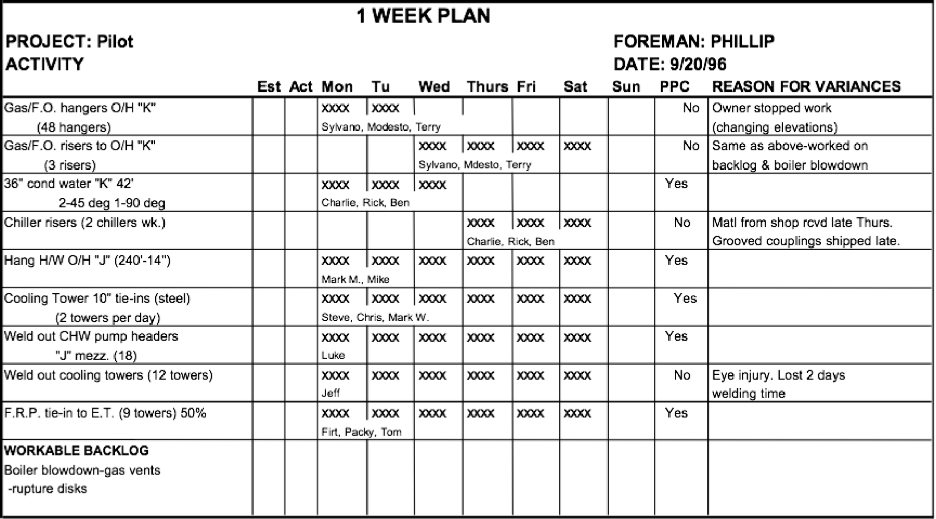
Construction Weekly Work Plan

Slide 32
Pull Planning: Designing the Network of Commitments
Produces the best possible plan by involving all with relevant expertise planning near action.
Rehearsing together
  Aligns understanding, reveals unexpected interactions, problems and value adding opportunities: Builds relationship.
  Assures that everyone in a phase understands and supports the plan by the working as a team.
  Assures the selection of value adding tasks that release other work by working backwards from the target completion date to produce a pull schedule.
  Establishes the amount of time available for ‘contingency’ and how it should be allocated.
32
Notes:
Alex story on gymnasium

Slide 33
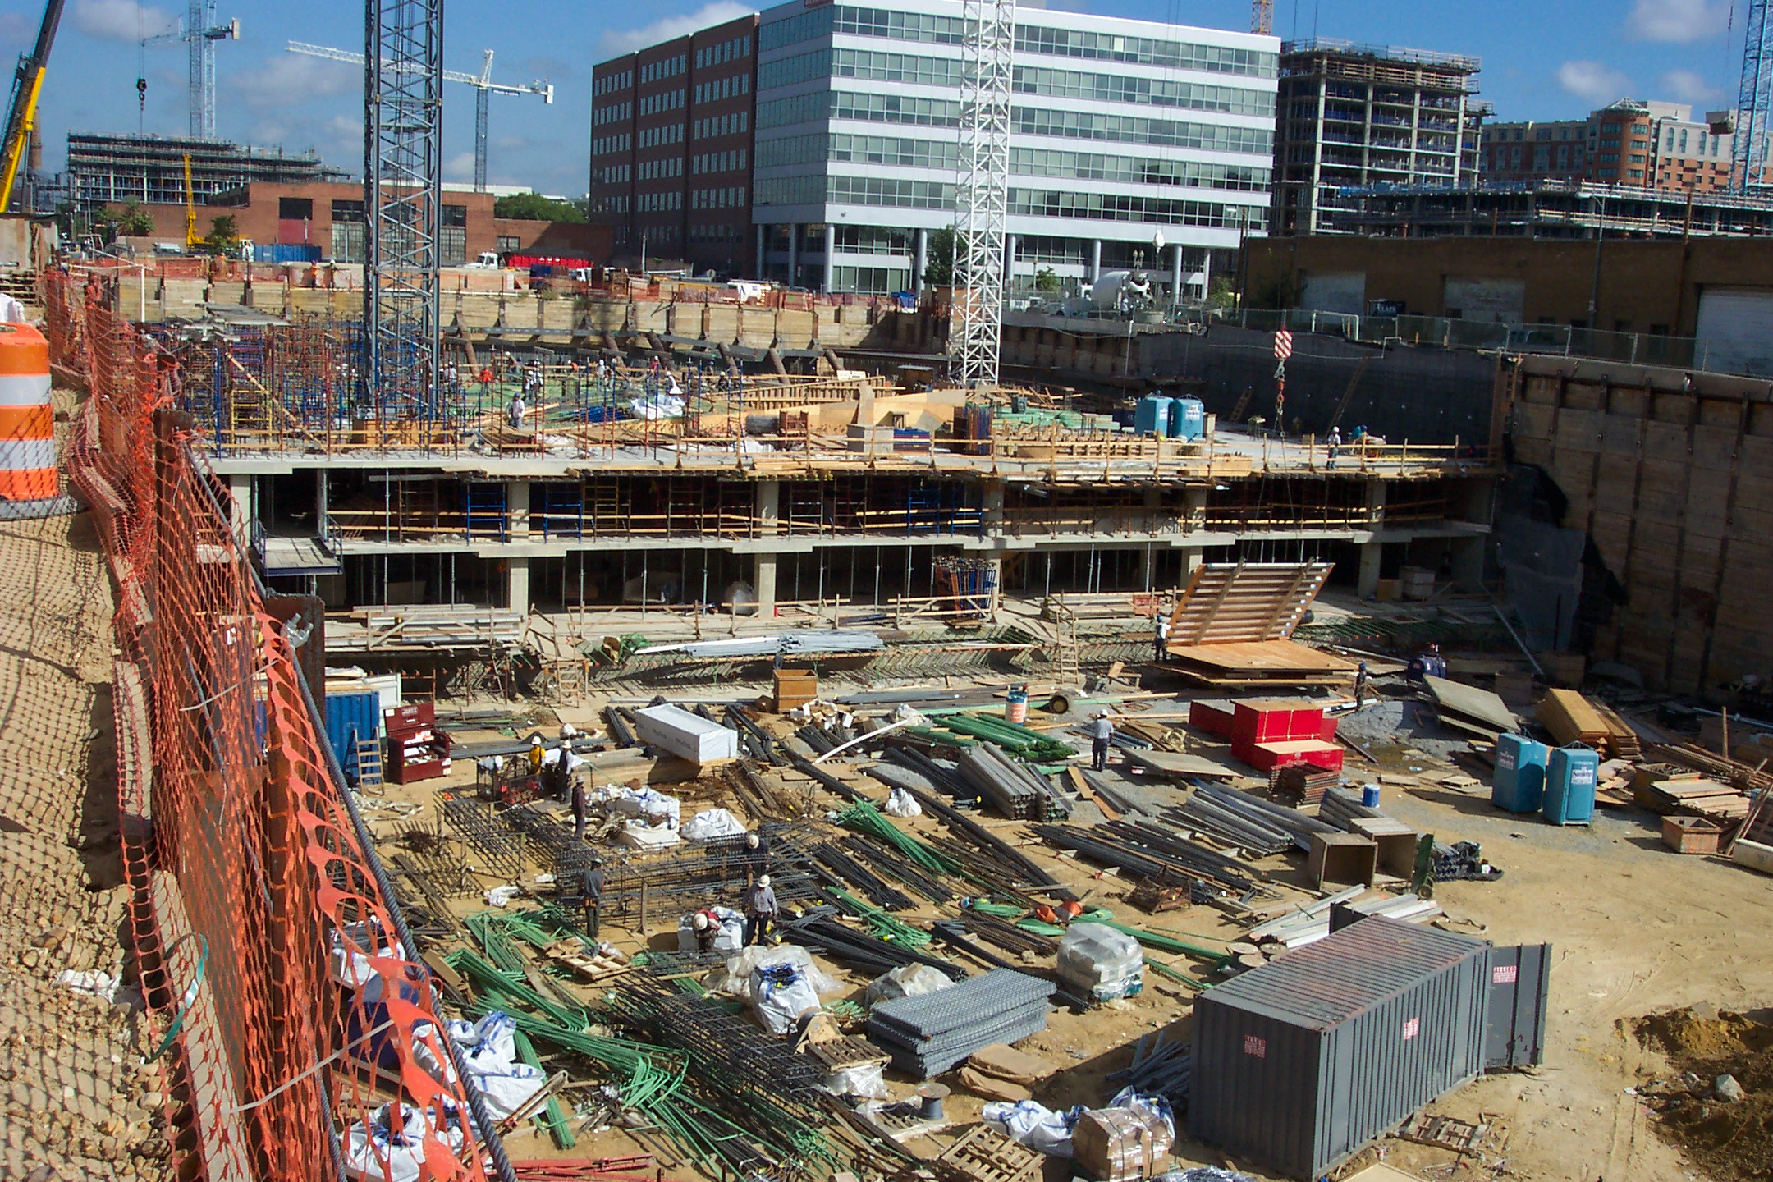

Slide 34
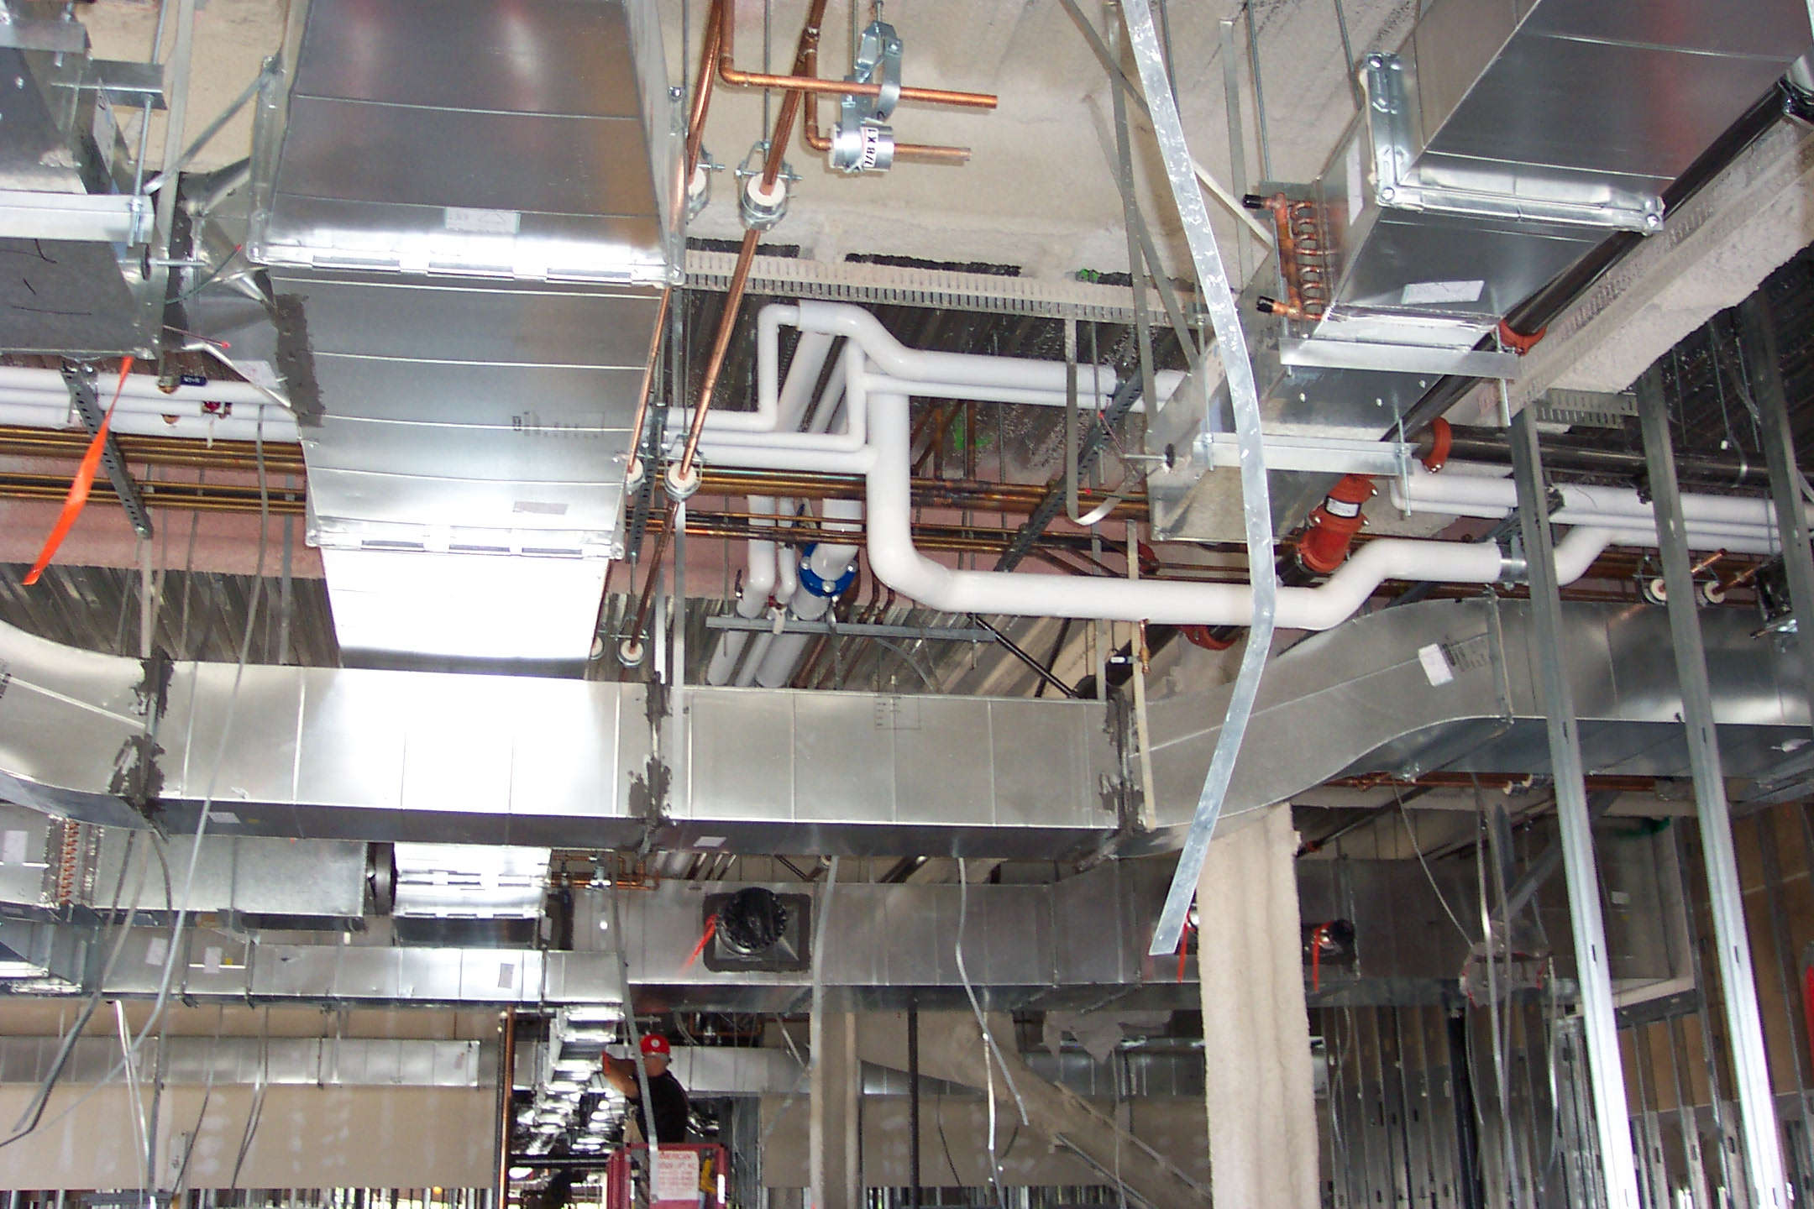
34

Slide 35
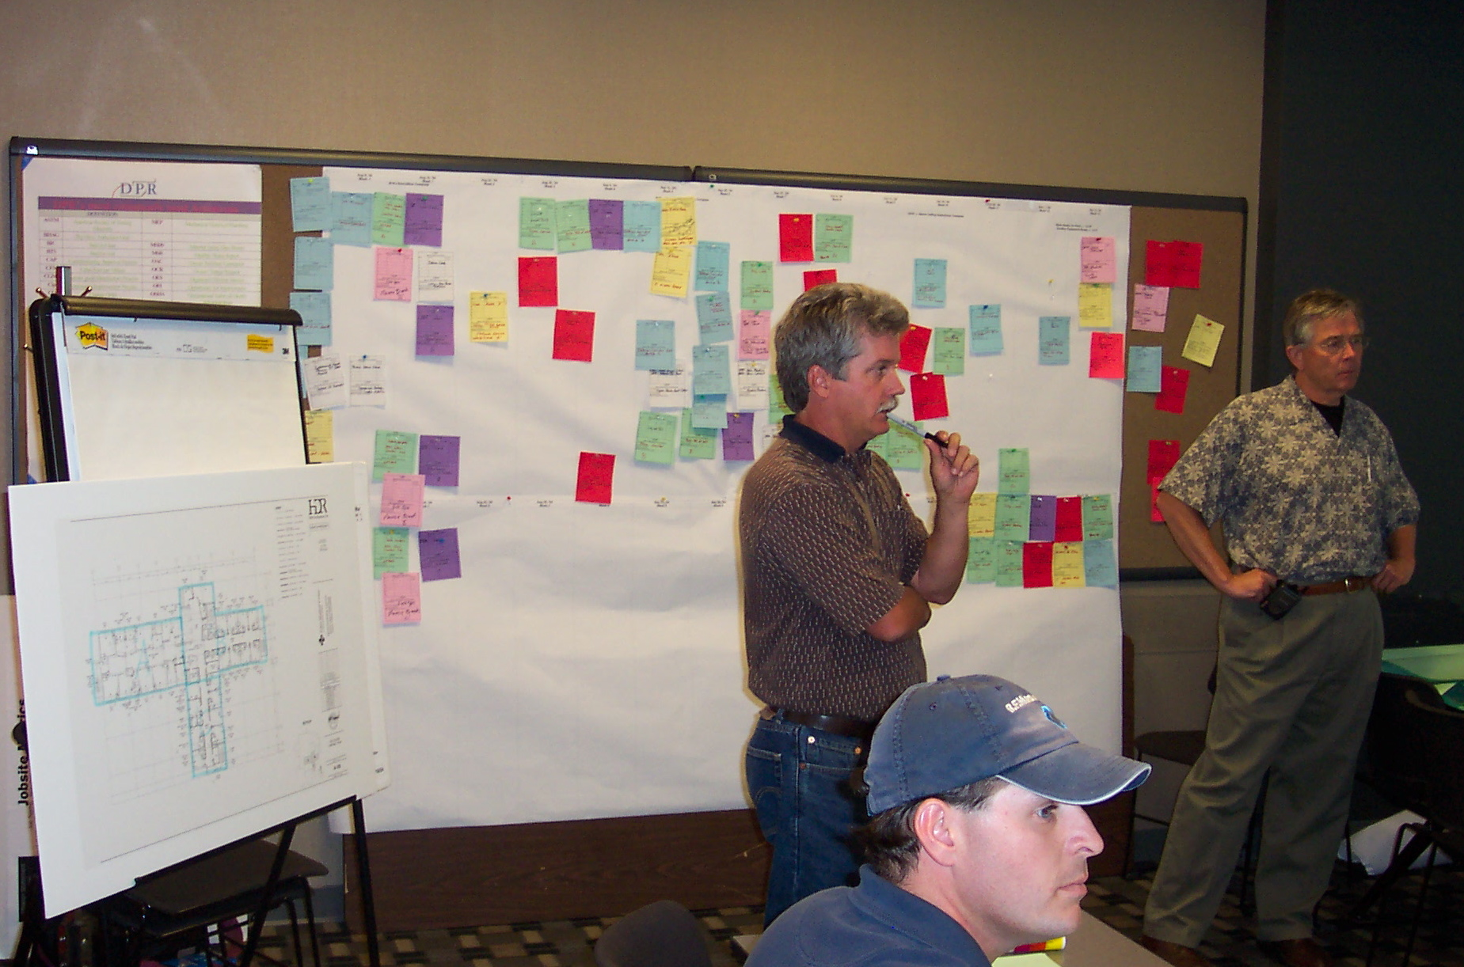
35

Slide 36
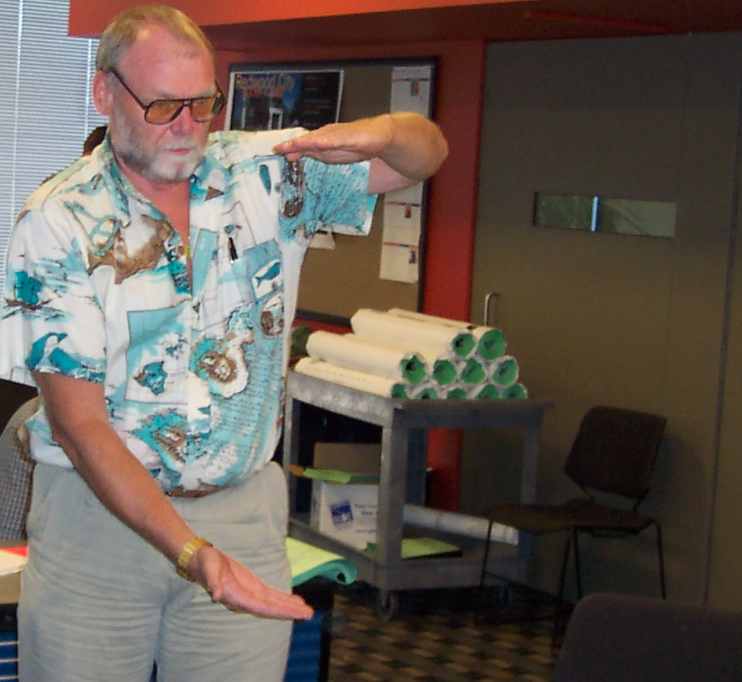
36

Slide 37
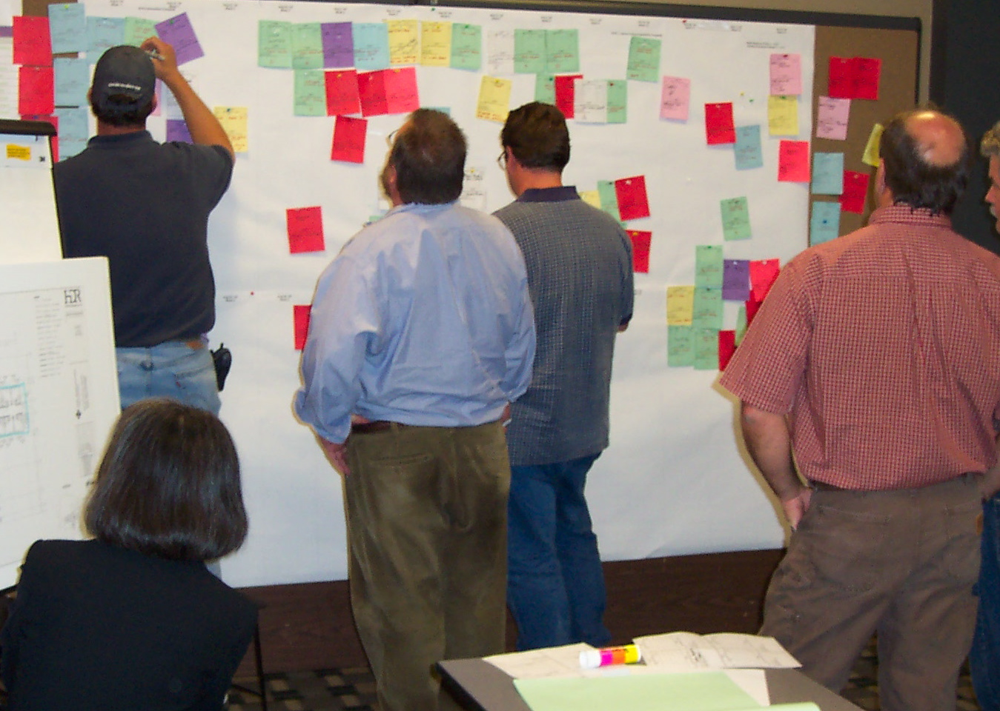
37

Slide 38
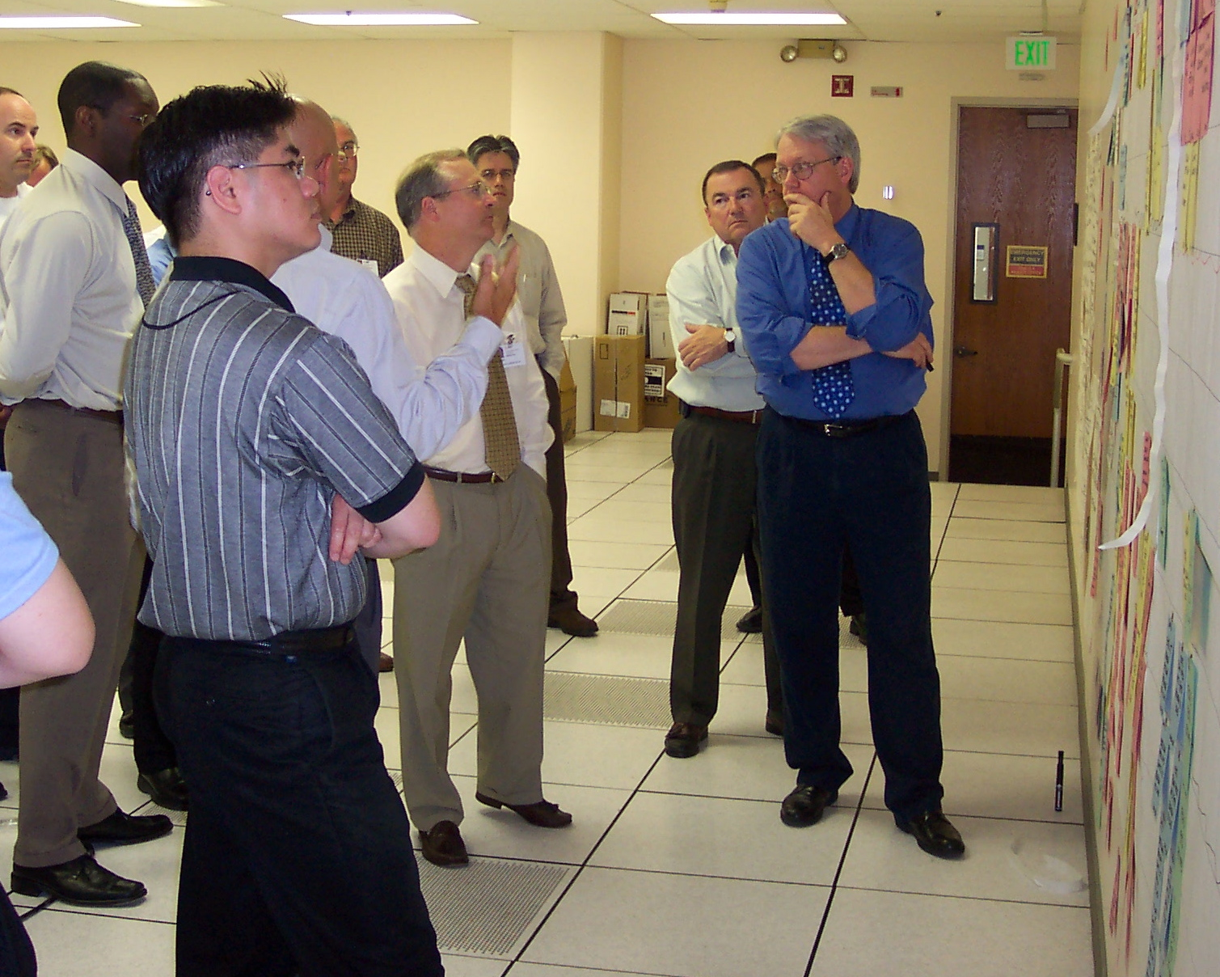
38

Slide 39
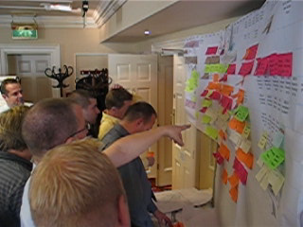
Notes:
The best technology for this team planning, at least the best technology so far discovered, is stickies-on-a-wall. The name ‘pull scheduling’ comes from the practice of working backwards from some near term milestone, often an integrating event where the work of multiple specialists, members of the project team playing different roles, is aligned and synchronized. This technique can be applied to explode master schedule tasks into greater level of detail, but can also be used by any team working on any shared tasks.

Slide 40
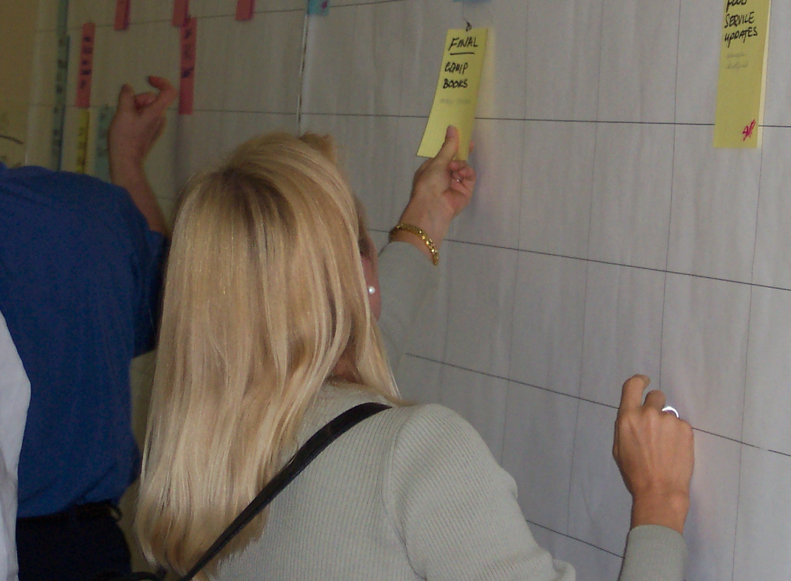

Slide 41
Functions of Master Schedules
Demonstrate the feasibility of completing the work within the available time
Develop and display execution strategies
Determine when long lead items will be needed
Identify milestones important to client or stakeholders
41

Slide 42
Essential Planning Questions
Are we confident we can deliver the project within the set limits?
Who holds the promise to make this happen?
Master Scheduling
Milestones
Do we understand how we are going to do the work?
Have we designed the network of commitments to make it happen?
Are we confident we can deliver the milestone?
Pull Scheduling
Specify hand off
Lookahead Planning
Is the network of commitments active?
Are reliable promises in place to make work ready in the right sequence and amounts to deliver the milestone?
Are we confident the work will begin and end as planned?
Make ready & launch
Weekly Work Planning
How will we coordinate and adjust?
Have we promised our tasks will be done as planned or said no?
Promise
Learning
What have we learned, what needs changing so we can improve our performance?
Measure PPC, act on reasons
for failure to keep promises
42
Notes:
We think we are already doing it.
There are some good ideas here - we will adapt the system to our situation.
Other people need to change their practices.
Fear of looking like a beginner.

Slide 43
Project Management Works
When Practices, Systems and Leadership produce coherent commitments connecting the promise of the project to the work of specialists, and coordinates their actions.
  Creating predictable workflow within and between workgroups
  Allowing decisions to be delayed to the last responsible moment.
  Adjusting appropriately in the moment to increase value and reduce waste.
43

Slide 44
What are your takeaways from what you have heard about coordination and control?
…

Slide 45
What questions have been provoked?
…

Slide 46
Project Management Works
When Practices, Systems and Leadership produce coherent commitments connecting the promise of the project to the work of specialists, and coordinates their actions.
  Creating predictable workflow within and between workgroups
  Allowing decisions to be delayed to the last responsible moment.
  Adjusting appropriately in the moment to increase value and reduce waste.
Taking responsibility for the details of production at each level the place to start.
46

Slide 47
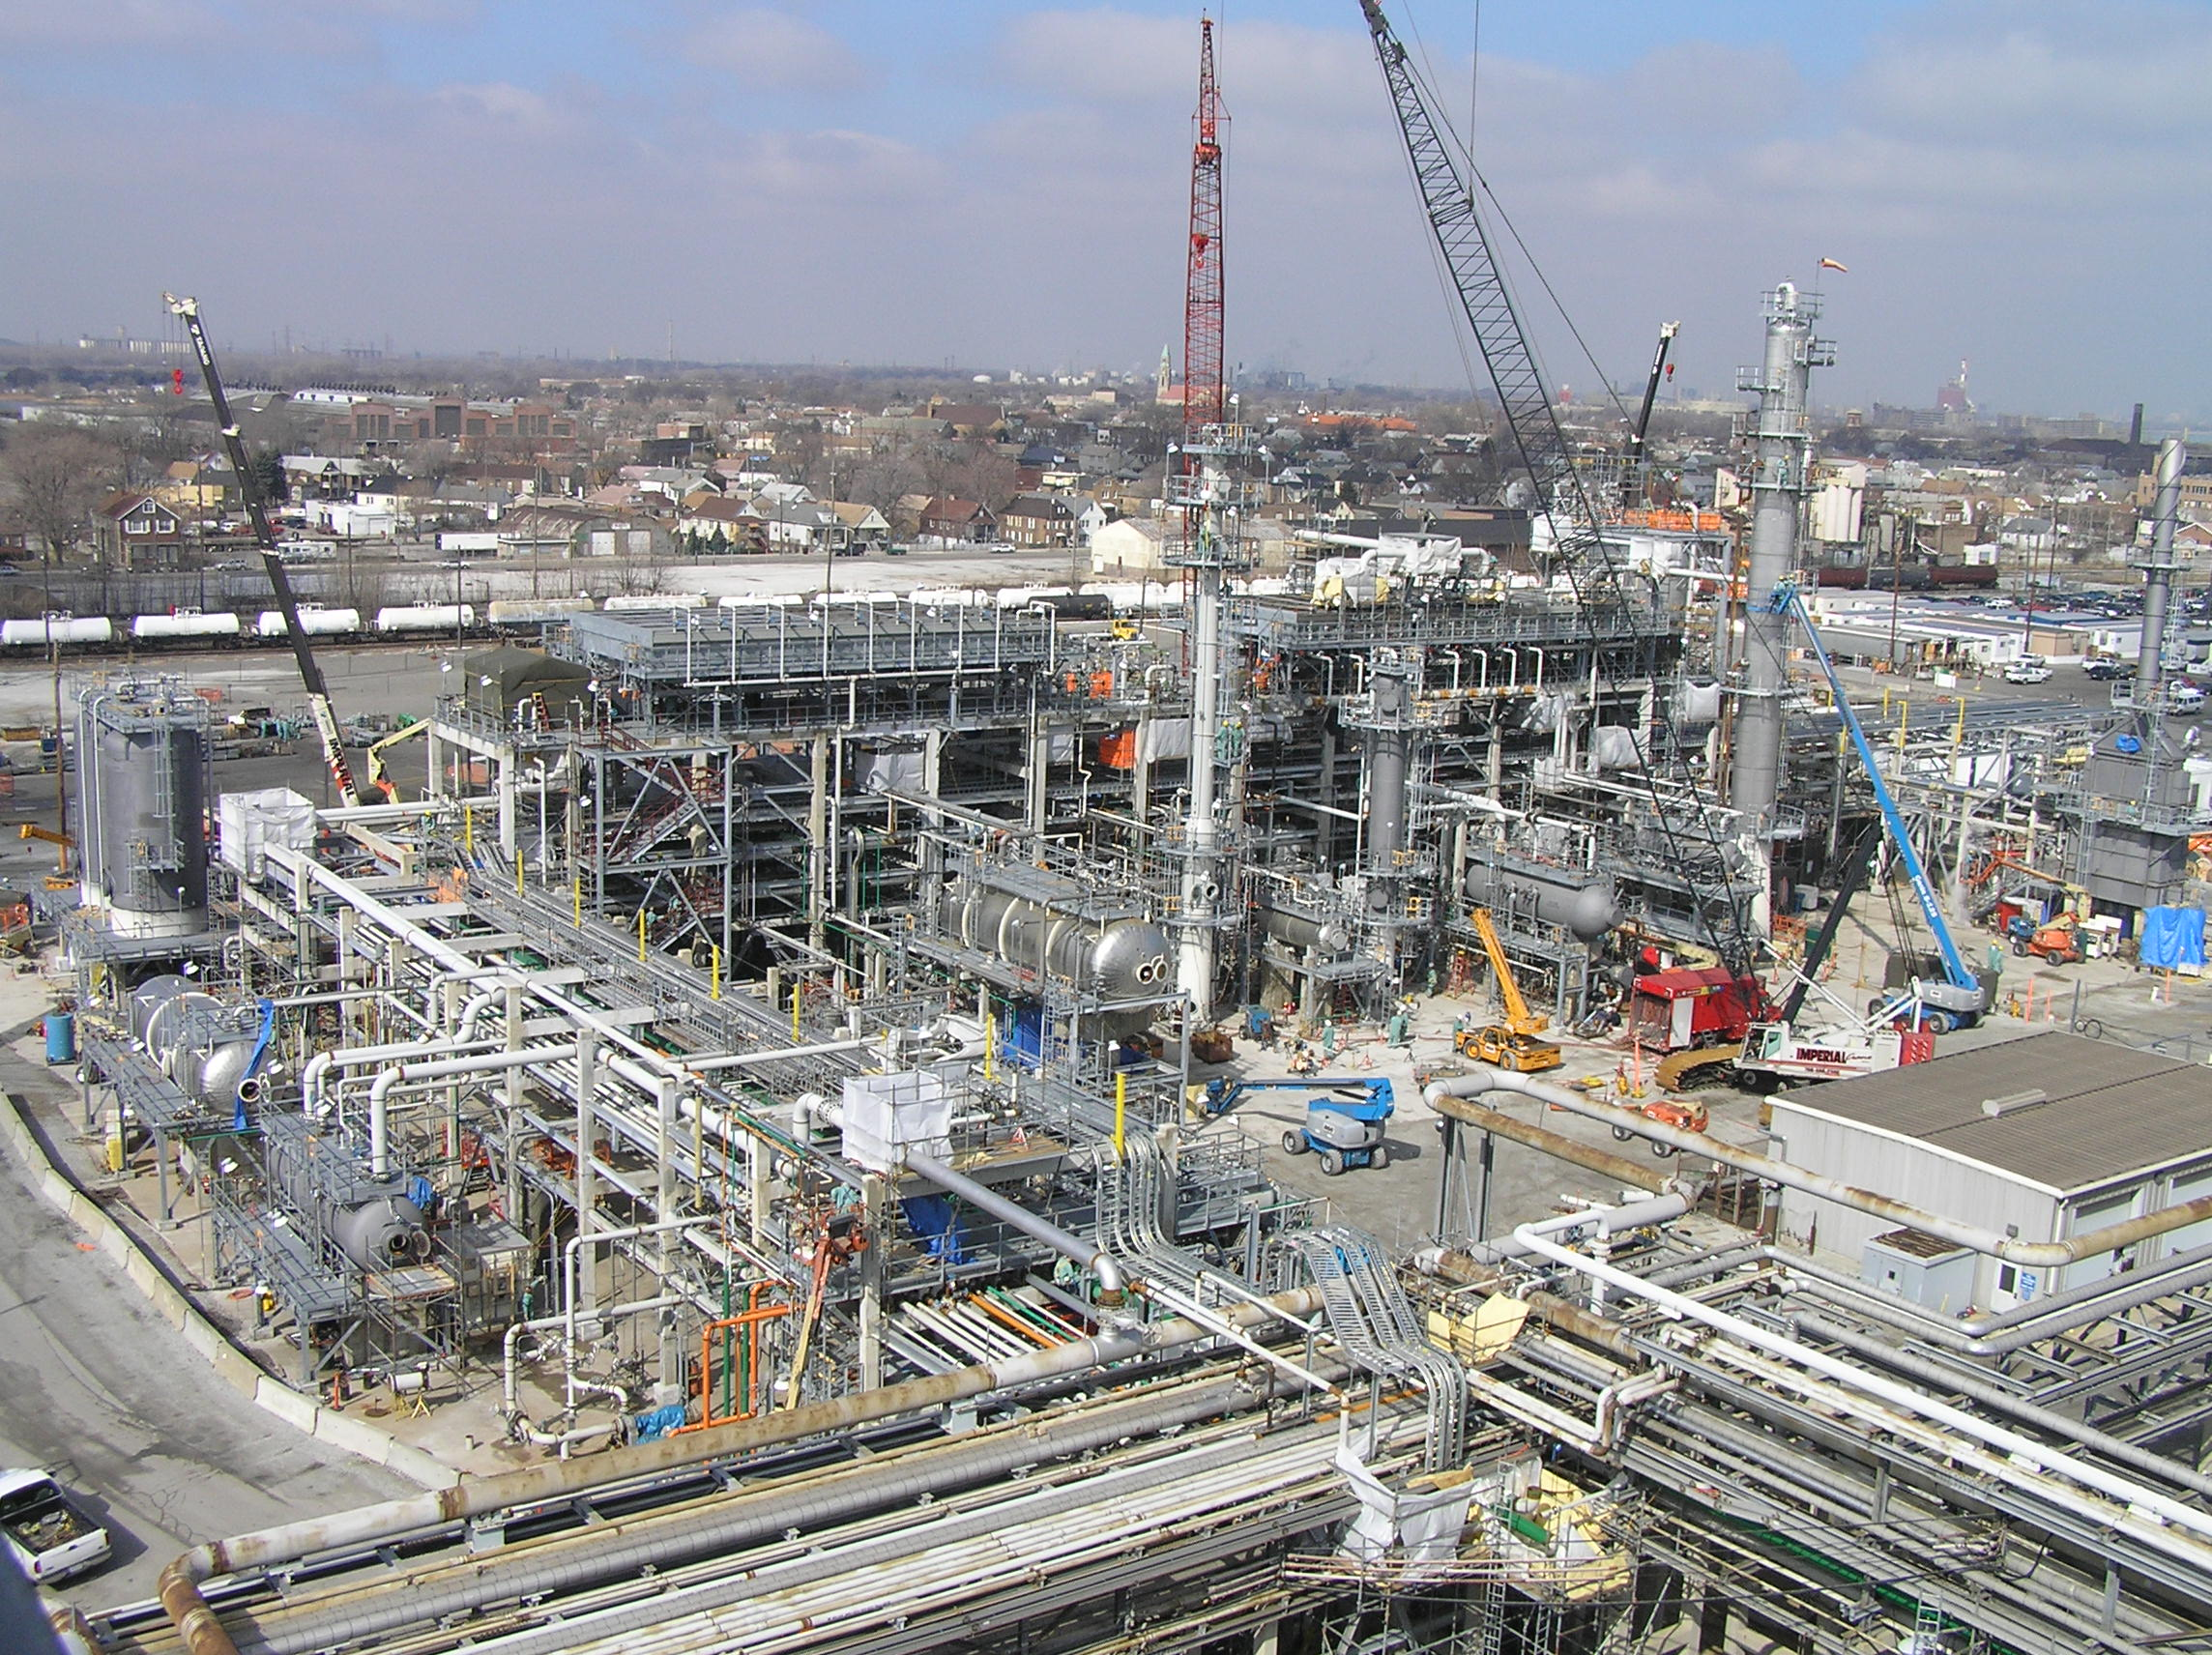
BP ULSD Project Overview
Subcontractor Case: BMW Constructors
BP Whiting Refinery Project
Courtesy of Strategic Project Solutions
47

Slide 48
COST CONTROL
 | BP's APPROPRIATIONS BUDGET (SEE NOTES 1 & 2) |  | FORECAST ACTUAL @ COMPLETION (SEE NOTES 1, 2 & 3) | FORECAST SAVINGS @ COMPLETION (SEE NOTES 1,3 & 4)
Direct Labor | $20,000,000 |  | $15,400,000 | $4,600,000 | 23%
Indirect Labor, Misc. Material & Supplies, Management & Support Staff Expense, Implementation Support | $22,000,000 |  | $21,140,000 | $860,000 | 4%
TOTAL COST | $42,000,000 |  | $36,540,000 | $5,460,000 | 13%
NOTES
1) Base Scope
2) Does NOT include Implementation Support Investment of $400,000
3) Includes actual Implementation Support Investment of ~ $400,000
4) at 85% Complete
Courtesy of Strategic Project Solutions

Slide 49
 | CRAFT BUY-IN and PRODUCTIVITY
 | LEVEL OF BUY-IN | CRAFT/SCOPE | DIRECT LABOR JOB-TO-DATE PRODUCTIVITY¹ | JOB-TO-DATE OR FORECAST SAVINGS/ OVERRUN
 | LOW | ELECTRICAL - ELECTRICAL SYSTEMS | 0.84 | ($0.50 MM)
 | MEDIUM | CIVIL & STRUCTURAL - FOUNDATIONS & STRECTURAL STEEL | 1.06 | $1.90 MM
 | HIGH | MECHANICAL - PIPING | 1.31 | $2.50 MM
 |  | TOTAL | 1.11 | $3.90 MM
 | NOTES | 1) Budgeted productivity equals 1.00
Courtesy of Strategic Project Solutions

Slide 50
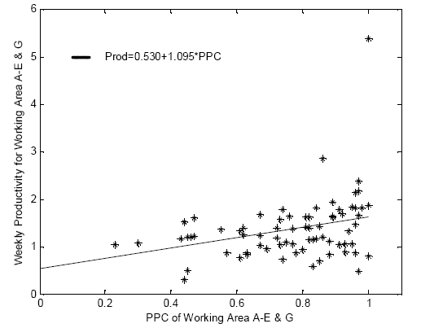
Correlation between PPC and Productivity
Example: If PPC=80%, productivity=1.21; 21% better than budget

Slide 51
Lean in the Construction Industry:
Three Connected Opportunities
IMPECCABLE COORDINATION
ORGANIZING PROJECTS AS PRODUCTION SYSTEMS
THE PROJECT AS A COLLECTIVE ENTERPRISE
© Lean Construction Institute, 2009
Notes:
What if every member of the team shared completely the responsibility for the entire project and set about correcting deficiencies or problems wherever they popped up without regard to who caused the problem or who is going to pay for it?
What if all team members were friends looking out for the interest of the Client and each other, applauding the successes of each other and sharing the pain of each others failures?
What if all of the design and construction entities on a project could be organized in such a way that they all functioned as if they truly were a single company with a single goal and with no competition amongst themselves for profit or recognition?

Slide 52
Production System Design:
The Structure and Management of Work
Assemble airplanes in 5 connected steps.
Three timed period separated by reflection, learning and improvement.
Assembly, inventory, batching, signaling, motivation, control and improvement.
The relationship between product and process design

Slide 53
Phase 1-3 Assembly Layout
WS2
Incoming Queues
WS3
WS1
WS4
WS6
WS5
(QC)

Slide 54
Phase 1 Logistics
Workstations in work flow sequence
Materials located at workstation
Workstations 2-5 have an incoming queue space
Completed Batches of 5 placed in queue space of next station
Batches remain together until final inspection

Slide 55
Phase 1 Policies
Workers perform only their assigned tasks - NO THINKING
Maintain Batch integrity - BUILD IT IF YOU CAN and PASS IT ON IF YOU CAN’T.
QC Problems only detected by Inspector - NO FEEDBACK - NO TALKING
All QC problems set aside as rework - TURN UPSIDE DOWN
QC Inspector announces first good plane.
Assemblers are paid by the piece.

Slide 56
Performance Metrics
Planes: the number of good planes produced in each 6 minute phase.
Time: the time it takes the first good plane to get through the system.
Rework: the number of planes turned upside to indicate defects in configuration or fit.
Work-in-Progress Inventory (WIP): the number of subassemblies on the table at the end of the 6 minute phase.

Slide 57
Your Hypotheses
How many good planes will your team produce in Phase I?
How long will it take for you to produce the first good plane?
How much rework will you generate (planes turned upside down)?
How much WIP will you generate (subassemblies left on the table)?

Slide 58
How could this system be redesigned for better performance?
Notes:
Ask this at end of debriefing Phase I. Record all suggestions, then review Phase 2 rule (system redesign) changes and circle on flip chart those suggestions being introduced in Phase 2. Add any not already on the flip chart—e.g., pull is often overlooked.

Slide 59
Phase 2 Logistics
Workers may have only one assembly at their workstation
Only 1 assembly allowed in queue space between stations (Batch size of 1)
Assembly can only be placed in queue when it is empty (pull mechanism).
Workstations in Work Flow Sequence
Materials located at station
Stations 2-5 have an incoming queue space

Slide 60
Phase 2 Policies
QC Problems may be verbalized by any worker
  SOME THINKING and TALKING ALLOWED
All QC problems set aside as rework at station discovered.
  TURN UPSIDE DOWN
Everyone is paid hourly wages plus a bonus for team performance.
Workers perform only their assigned tasks
Workers cannot fix QC problems from upstream
Inspector announces first good plane.

Slide 61
Your Hypotheses
How many good planes will your team produce in Phase II?
How long will it take for you to produce the first good plane?
How much rework will you generate (planes turned upside down)?
How much WIP will you generate (subassemblies left on the table)?

Slide 62
Phase 3 Logistics
Use Phase 3 Instruction Sheets.
Workers may have only one assembly at their workstation
Only 1 assembly allowed in queue space between stations (Batch size of 1)
Components can only be placed in queue when it is empty (pull mechanism).
Workstations in Work Flow Sequence
Materials located at station
Stations 2-5 have an incoming queue space

Slide 63
Phase 3 Policies
Workers perform ANY step in the production process.
QC problems can be fixed by any worker - Fix it when you find it.
No restrictions on talking.
Everyone is paid hourly wages plus a bonus for team performance.
Inspector announces first good plane.

Slide 64
Your Hypotheses
How many good planes will your team produce in Phase III?
How long will it take for you to produce the first good plane?
How much rework will you generate (planes turned upside down)?
How much WIP will you generate (subassemblies left on the table)?

Slide 65
Throughput
40
35
30
25
Phase 0
Phase I
20
Phase II
15
Phase III
10
Phase 0
not played here
5
0
1
2
3
4
5
6
7
8
9
1
1
1
1
1
1
1
0
1
2
3
4
5
6
Phase 0
4
1
0
10
3
9
8
3
5
5
4
4
4
2
5
3
Phase I
10
2
5
17
14
10
15
14
15
10
11
9
14
8
13
15
Phase II
17
5
17
19
19
20
23
20
26
23
12
13
17
16
28
19
Phase III
26
23
33
26
25
30
30
30
37
26
36
25
30
30
36
23

Slide 66
Cycle Time
7:12
6:00
4:48
Phase 0
Phase I
3:36
Phase II
Phase III
2:24
Phase 0 not played here
1:12
0:00
1
2
3
4
5
6
7
8
9
10
11
12
13
14
15
16

Slide 67
Learning to see
Minimize the movement of materials and workers by sequencing and positioning of workstations (layout) and by maintaining materials at the workstations.
Release work (materials or information) from one workstation (specialist) to the next by pull versus push.
Minimize batch sizes to reduce cycle time.
Make everyone responsible for product quality.
Balance the workload at connected workstations.
Encourage and enable specialists to help one another as needed to maintain steady work flow (multiskilling).
Stop the line rather than release bad product to your ‘customer’.
Minimize changeover (“setup”) time to allow one piece flow.
Make the process transparent so the state of the system can be seen by anyone from anywhere.

Slide 68
What batches are found in construction projects?
Drawings for review and approval; e.g., Construction Documents, permit sets
Requests for Information (RFIs)
Requests from one specialist to another for more information than is needed at the time:
  ‘I need your design for the chillers’ when what’s actually needed is footprint and weight.
  ‘I need to know all penetrations through load bearing walls’ when what’s actually needed is to identify penetrations > 1 square meter.

Slide 69
What batches are found in construction projects?
The spacing between ‘lessons learned’; end of project, end of phase—long feedback loops
Spacing between trades
Orders for materials
???

Slide 70
Where might we look for ‘pull’ or ‘push’?
How does work product flow through networks of interdependent specialists…
  in design?
  in specification, fabrication and delivery of engineered-to-order products?
  in site assembly and commissioning?
How does each work group decide what work to do next?

Slide 71


Slide 72
The Airplane Game
What are the key points or lessons for you?
How might these apply to designing and making buildings? How could you use what you have learned on your projects?

Slide 73
Lean Project Delivery System
Purposes
Design
Concepts
Product
Design
Fabrication
& Logistics
Commissioning
Alteration &
Decommissioning
Constraints
Process
Design
Detailed
Engineering
Installation
Operations &
Maintenance
Project Definition
Lean Design
Lean Supply
Lean Assembly
Use
Production Control
Work Structuring
Learning
Loops
© Lean Construction Institute 2009
Notes:
Greg Howell and I developed this schema of the Lean Project Delivery System, in which Project Definition is represented as a process of aligning Ends, Means and Constraints.
So how is alignment achieved? We think alignment is achieved through a conversation that starts with the customer stating what they want to accomplish (have a place to live, capture a market for the goods they produce, provide a school so their children can be educated), the ends for which they think they may need means (an office building, a flat, a factory or a bridge), and also the constraints on those means; e.g., location, cost, time.
Once we move into Design, one key objective is to design product and process together; i.e., to decide at one time (or as near in time as feasible) what is to be built and how it is to be built—integrated product and process design. In Supply, a key is to synchronize fabrication, delivery and installation; just-in-time. Assembly does not end until the building is commissioned and functioning to target performance levels. The building is then put into Use, and inevitably goes through multiple re-designs before it is finally decommissioned.
Work Structuring and Production Control represent the overall management of the project; the first dedicated to the design of production processes and systems, and the second to execution of those systems.
The one grand learning loop, from project to project, represents multiple loops that occur between and within each phase and facet.

Slide 74
Essential Features of the Toyota Production System
Optimizing the system, not its parts
Controlling processes
Driving out variation
Decentralizing decisions
Rapid learning by everyone at every level every day

Slide 75
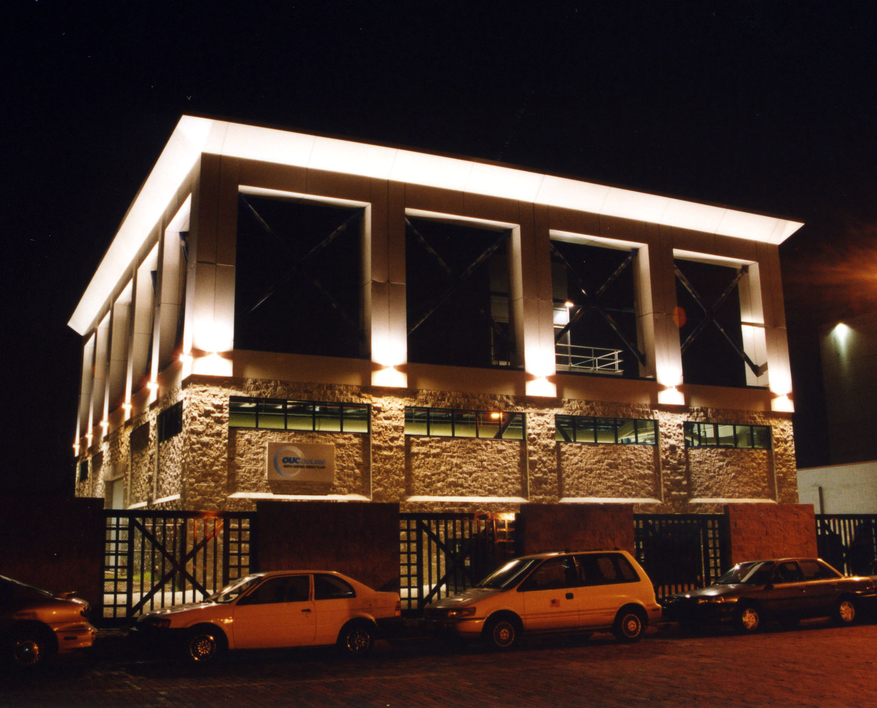

Slide 76
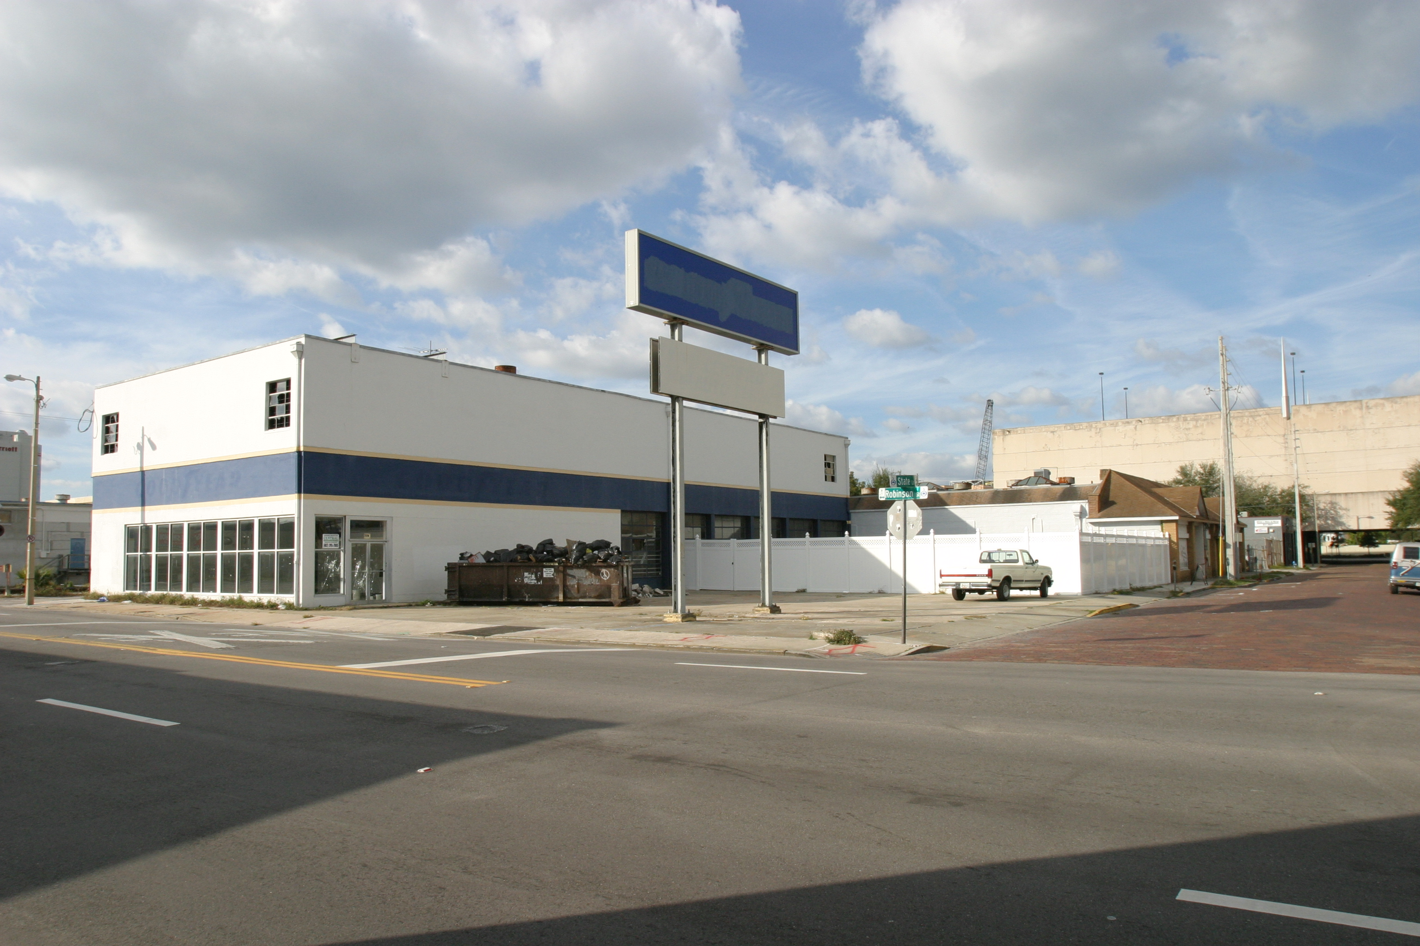
Site as it existed on November 30, 2003

Slide 77
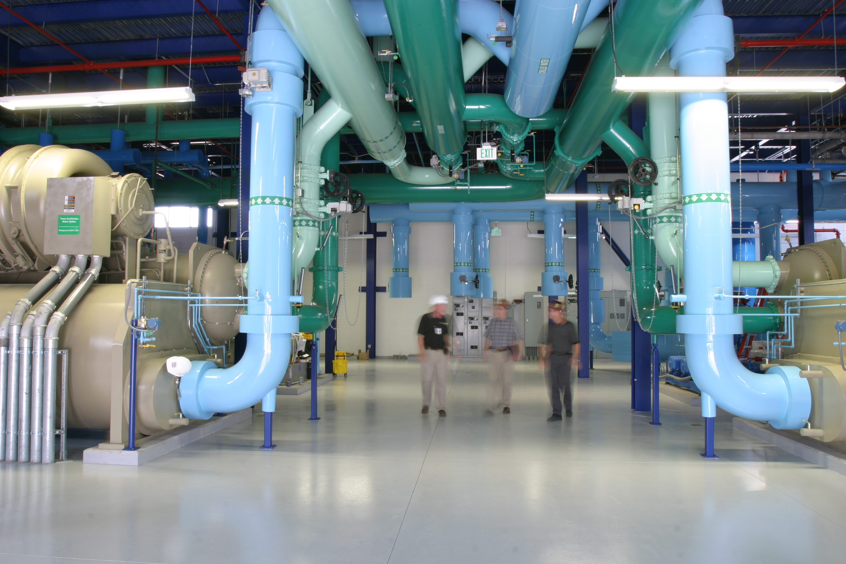

Slide 78
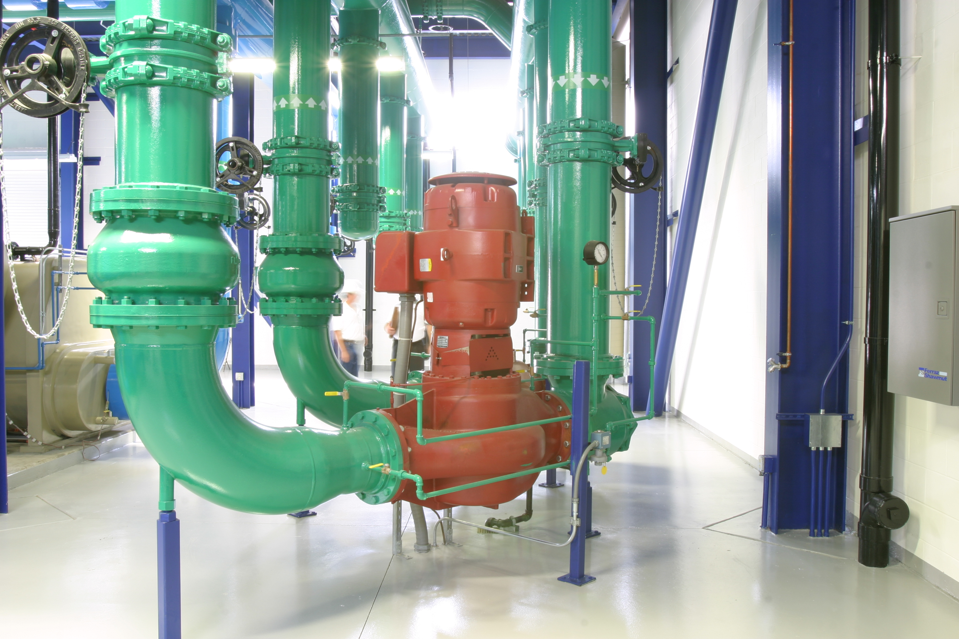
Vertical In-line Pumps

Slide 79
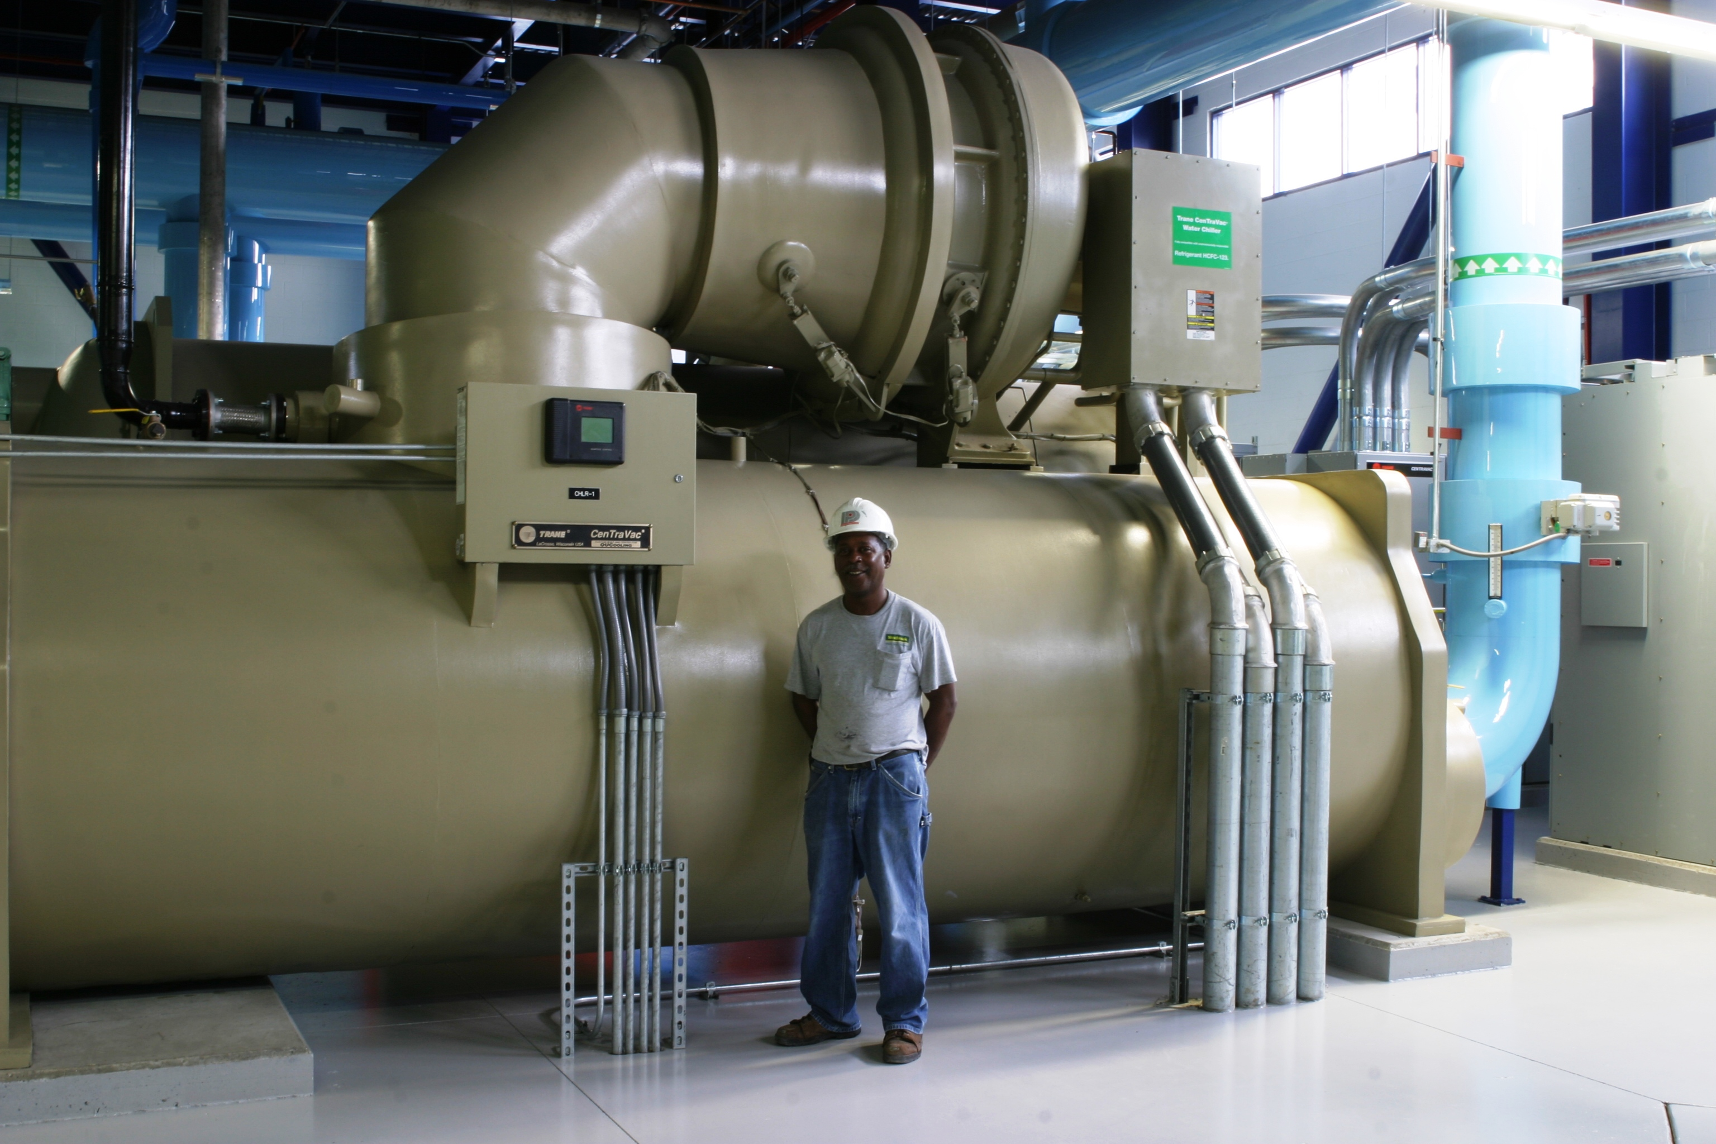
1,500 Ton Centrifugal Chiller

Slide 81
Planning Considerations
Delay decisions to last responsible moment
Create pull schedules
Only do work that releases that needed by downstream crews (important also in design)
Reliability of work flow

Slide 82
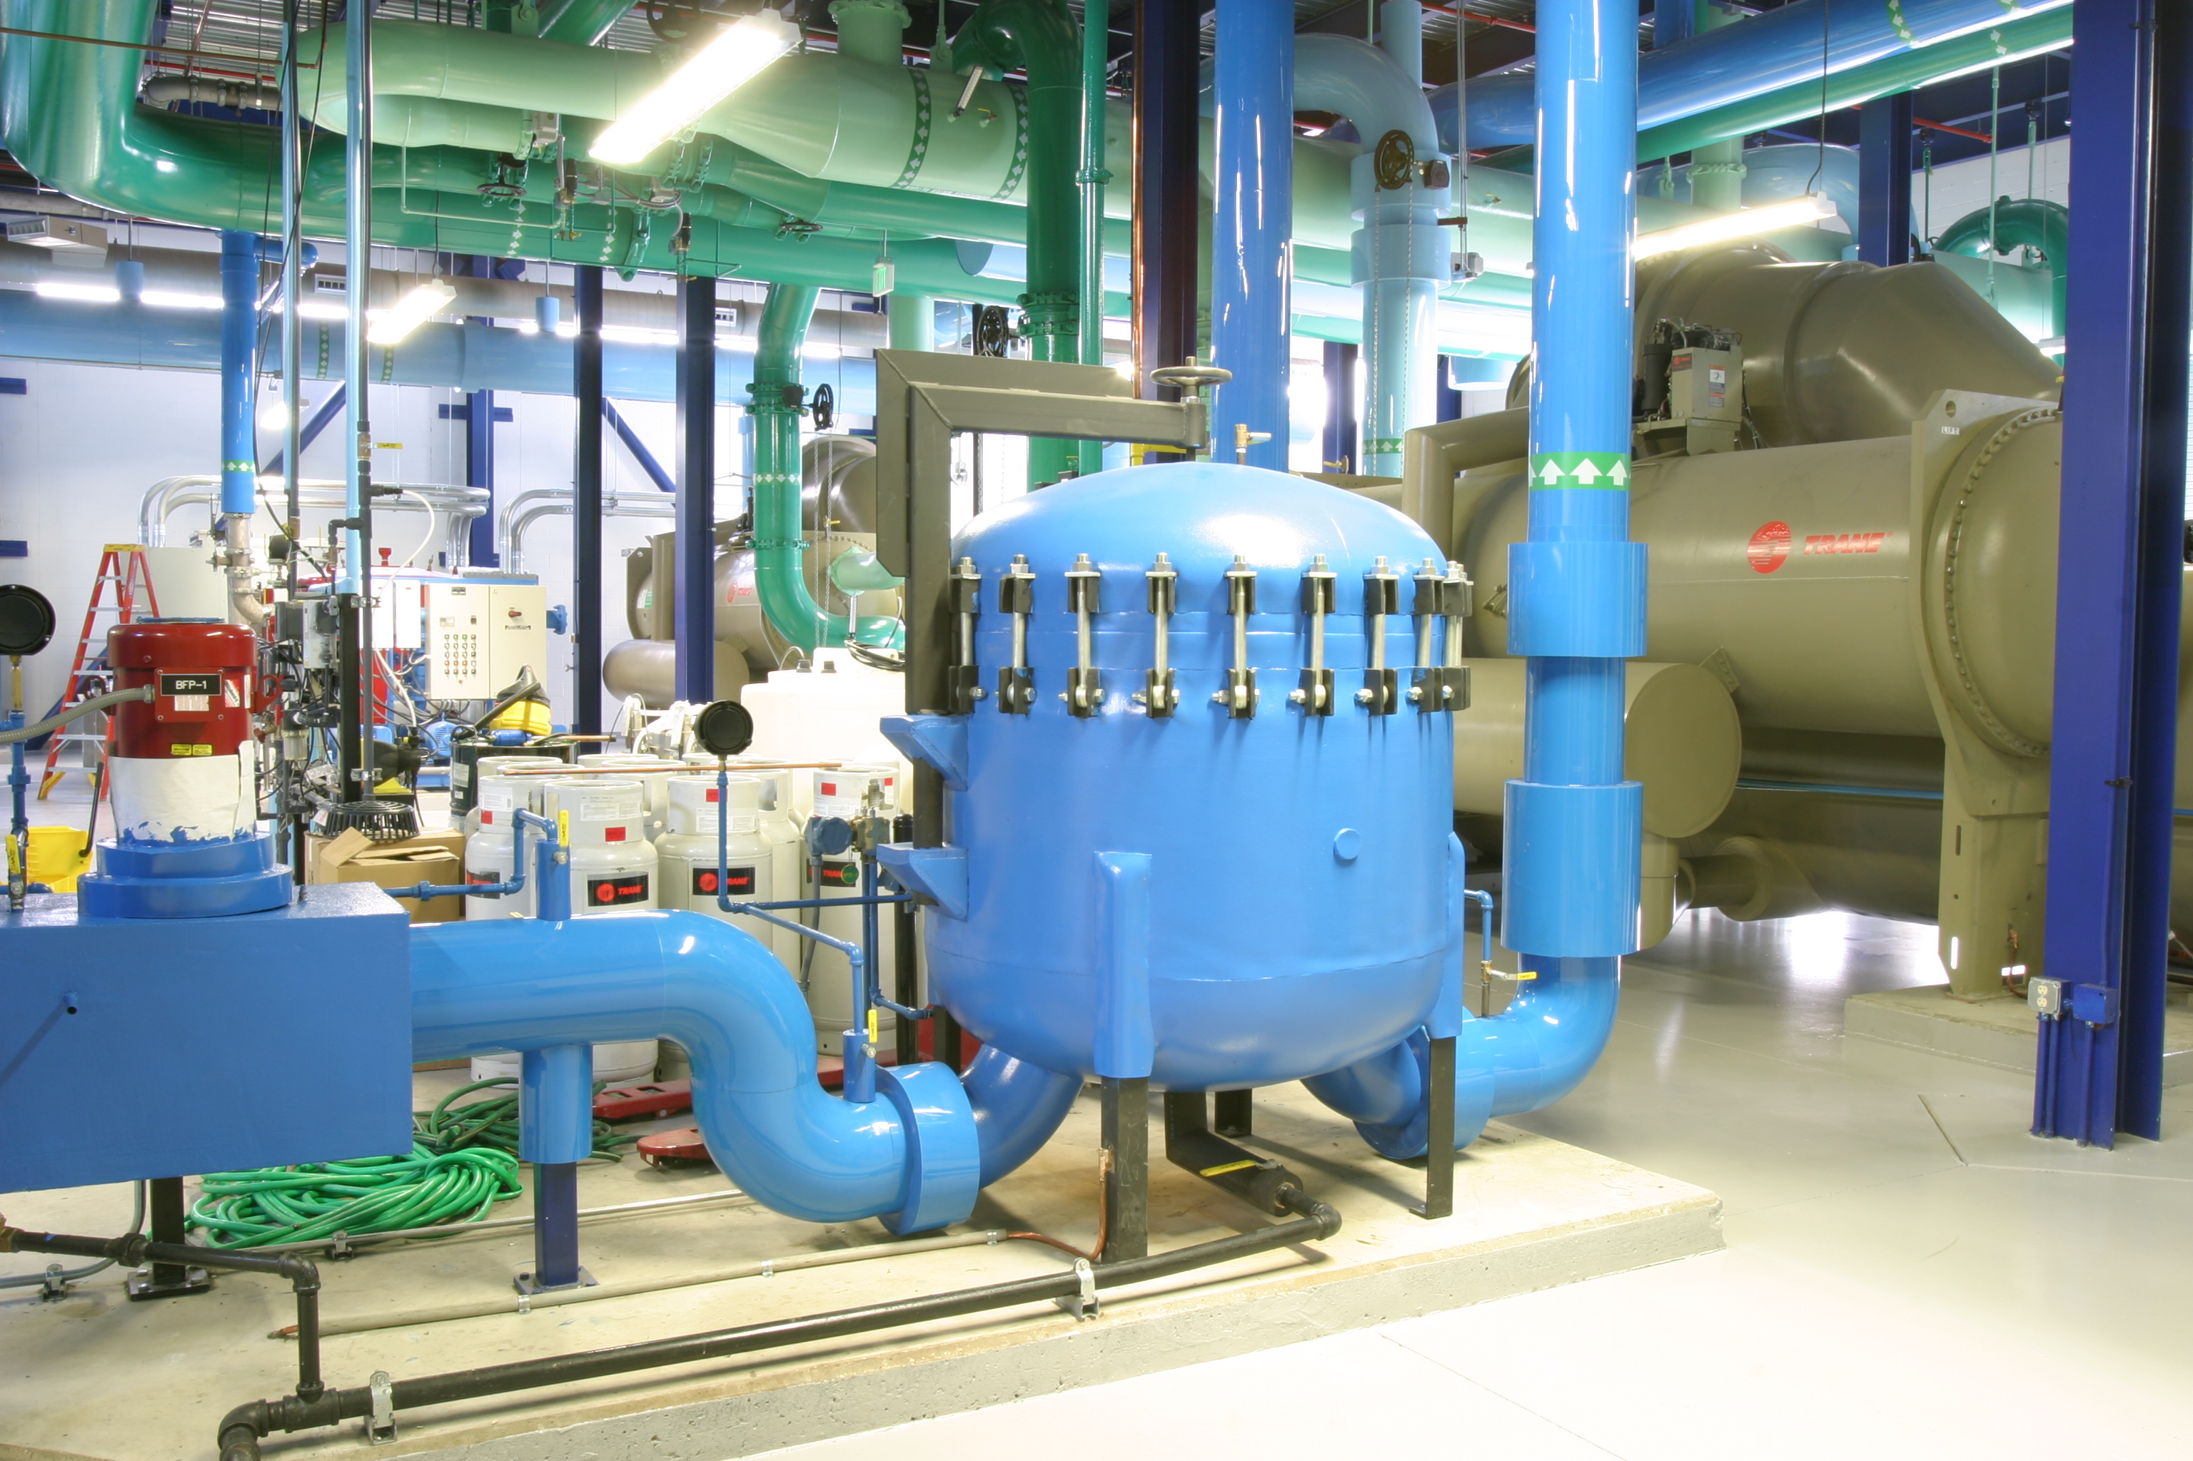

Slide 83
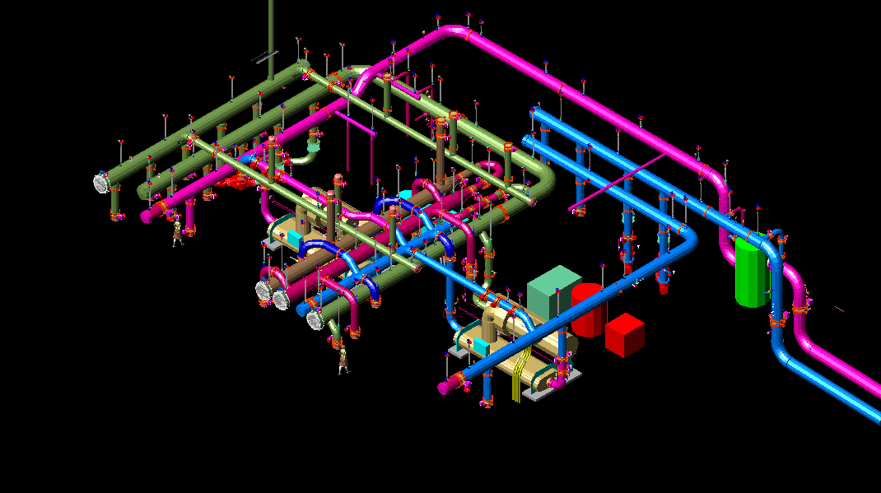

Slide 84
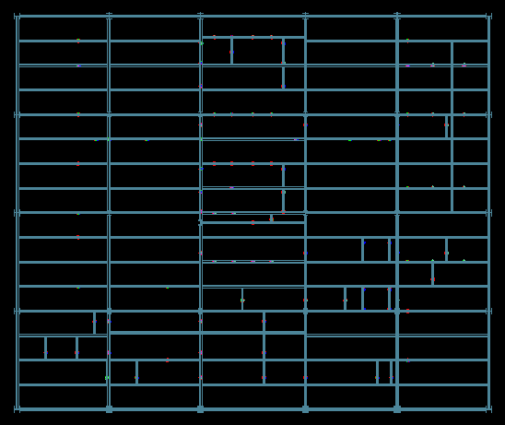
Notes:
Here we see pipe supports indicated on the structural plan by the mechanical contractor.
Also we can see that one column has been offset to accommodate the mechanical equipment.
The extra cross members were shown by the mechanical contractor and then properly sized by the structural engineer and provided by the steel fabricator.

Slide 85
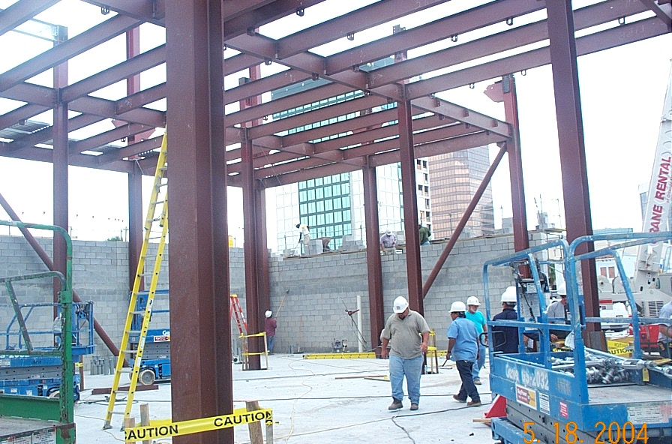

Slide 86
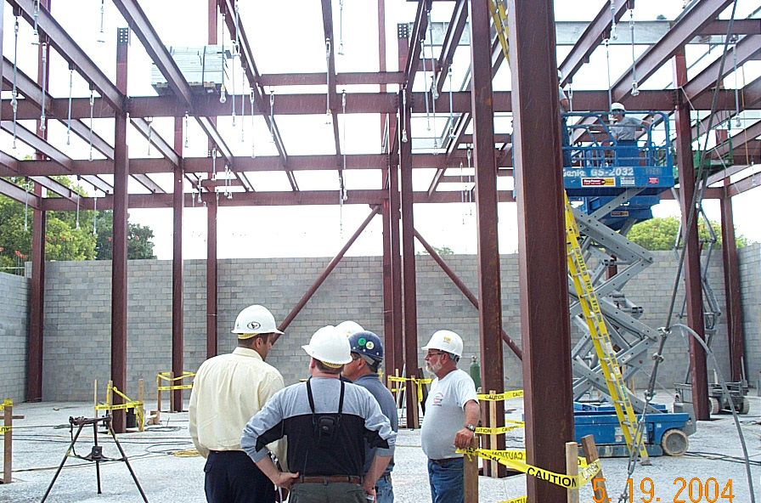

Slide 87
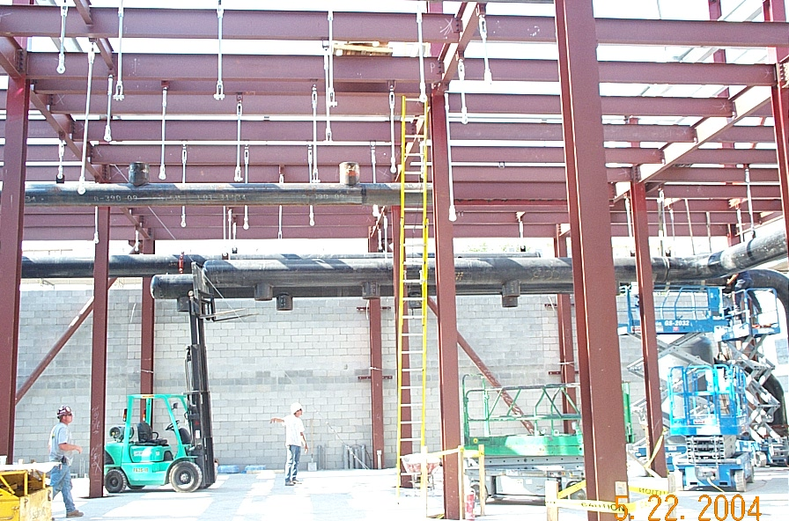
Notes:
The hangar Rod assemblies had all Been prefabricated and were installed in a single day before any pipe was on site
No measuring
No layout
No drilling
No welding
Just bolt them on

Slide 88
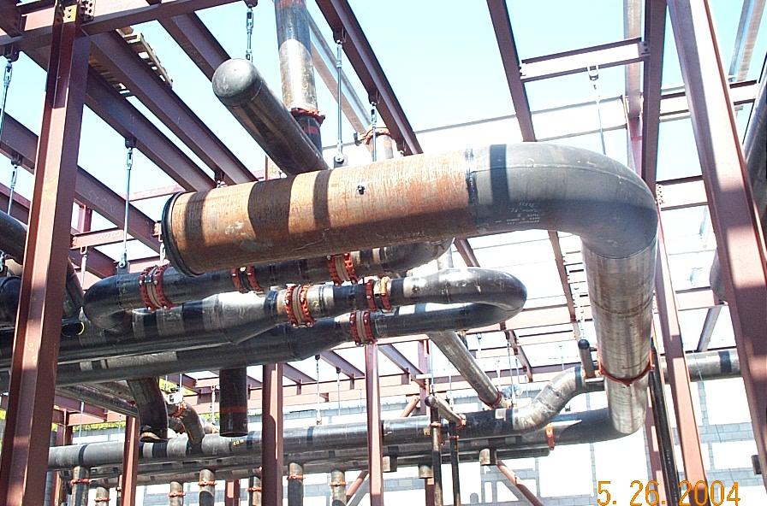
Notes:
The pipe was prefabricated with weldments in the proper locations. Lifting the pipe and attaching it to the appropriate hanger rods was a simple procedure and required little or no measuring.
Note that this method illuminated the need for the customary pipe hangers and the associated saddles.
Significant savings were realized in the insulation process. There was no need for the insulator to loosen hangers and then read tension them.

Slide 89
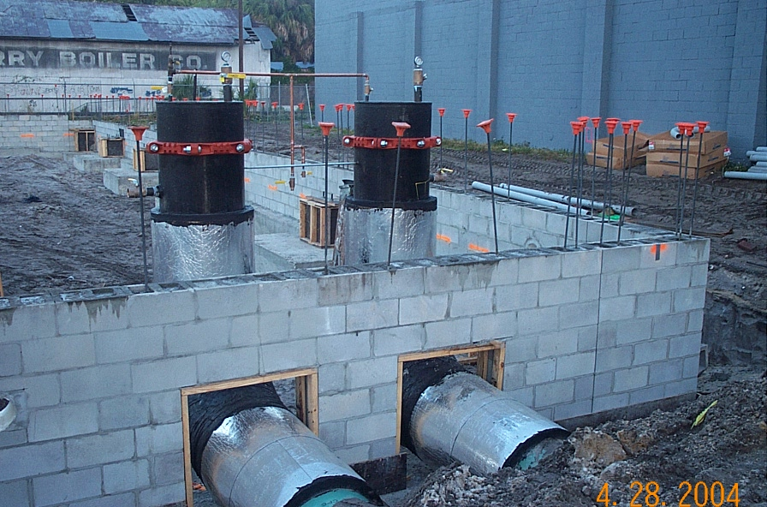

Slide 90
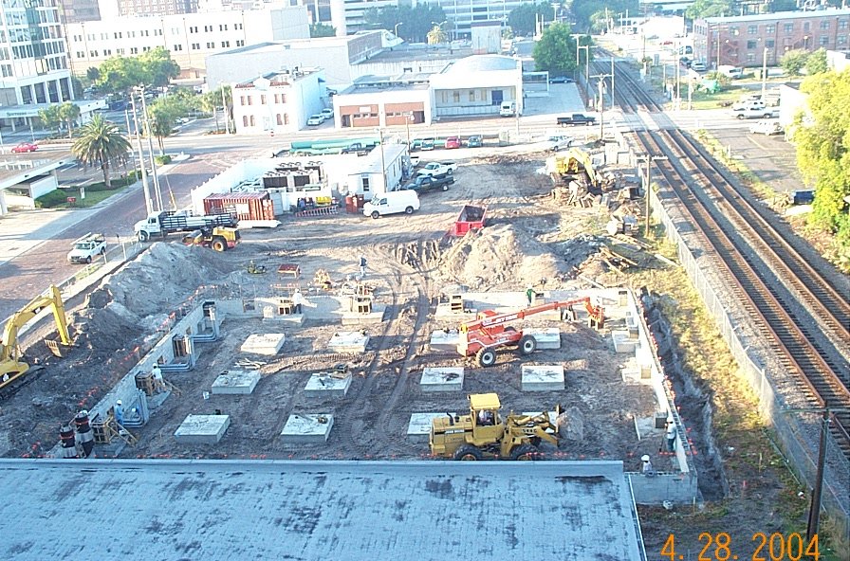
Notes:
The general contractor backfilled and compacted to an elevation 30" below grade and the site was turned over to the Team Member responsible for the electrical construction who laid 1 mile of 4" conduit without the need for any excavation. Seeing the entire grid laid out “above ground” as it were afforded the opportunity for accurate layout and verification. The GC then came back in and backfilled to grade using fire hoses to wash fine aggregate in and around the conduits. This innovation saved two weeks off of the schedule.

Slide 91
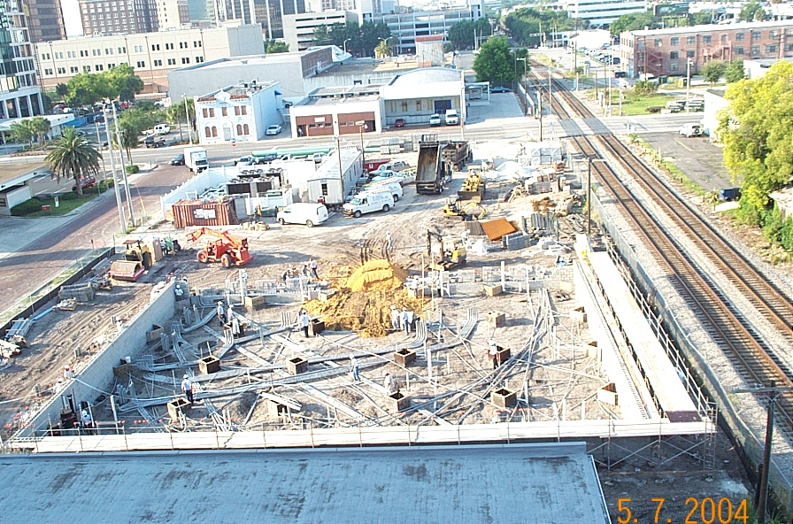

Slide 92
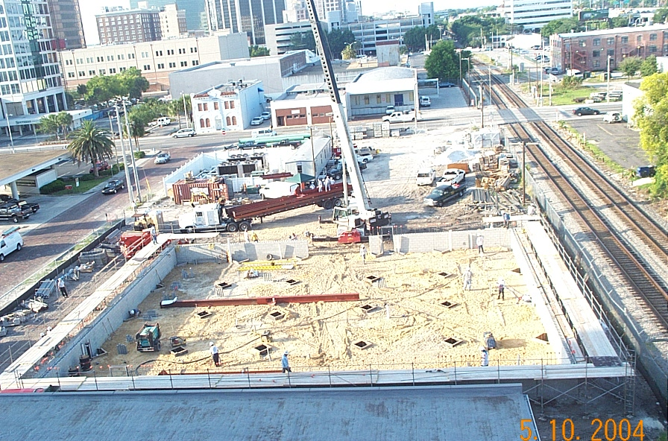

Slide 93
7/28/04

Slide 94
Schedule Considerations
Delay decisions to last responsible moment
Create pull schedules
Only work to release downstream crews (important also in design)
Reliability of work flow

Slide 95
SCHEDULE PERFORMANCE
Contract Date
DD Complete
Demolition Complete
Time lost to DDB
Permit Issued
Work Begins on Site
Plant Ready to Go
12/30/03
1/26/04
1/7/04
6 weeks
4/14/04
5/4/04
7/28/04

Slide 96
Putting the pieces together
Organization
Commercial Terms
Project
Delivery
Operating System
96

Slide 97
Project management common sense
Operating System
Commercial Terms
Organization
Command & Control
CPM
Transactional
Lean
Relational
Collaborative
Optimizing the project not the piece
Notes:
Decomposition model with simple sequential relations.
A contract management tool,
Provides ability to see big picture of and leverage on time, its allocation and management.
Effort to modify and improve it – Partnering and DB
Productivity

Slide 98
Lean in the Construction Industry: Three Connected Opportunities
THE PROJECT AS A COLLECTIVE ENTERPRISE
IMPECCABLE COORDINATION
ORGANIZING PROJECTS AS PRODUCTION SYSTEMS
© Lean Construction Institute, 2009

Slide 99
The Big Questions
What if every member of the team shared completely the responsibility for the entire project and set about correcting deficiencies or problems wherever they popped up without regard to who caused the problem or who is going to pay for it?
What if all team members were friends looking out for the interest of the Client and each other, applauding the successes of each other and sharing the pain of each others failures?
What if all of the design and construction entities on a project could be organized in such a way that they all functioned as if they truly were a single company with a single goal and with no competition amongst themselves for profit or recognition?
Greg Howell & Glenn Ballard, Lean Construction Institute
Notes:
What if every member of the design build team shared completely the responsibility for the entire project and set about correcting deficiencies or problems wherever they popped up without regard to who caused the problem or who is going to pay for it? What if all of the construction members were friends looking out for the interest of the Client and each other, applauding the successes of each other and sharing the pain of each others failures? What if all of the design and construction entities on a project, could be organized in such a way that they all functioned as if they truly were a single company with a single goal and with no competition amongst themselves for profit or recognition?

Slide 100
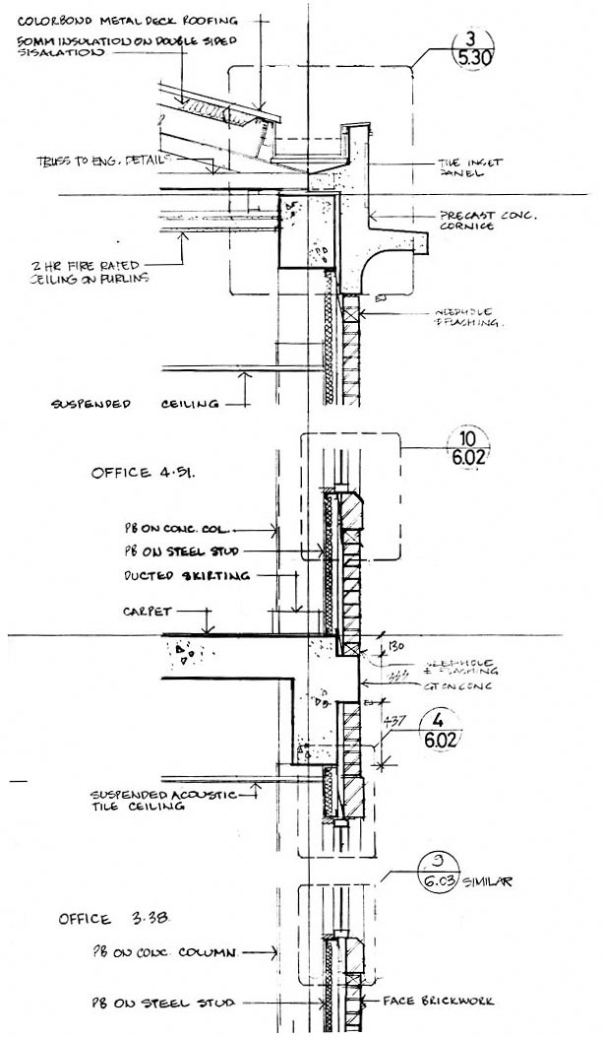
Buildings Leak at the Intersection of Contracts
Roofing contractor
Wall stud contractor
Caulking contractor
Window contractor
Masonry contractor
Waterproofing contractor
Concrete contractor
Structural steel contractor
Foundation contractor
Excavation contractor
Graphic courtesy of Todd Zabelle, Strategic Project Solutions
Notes:
With this complexity, we have developed highly inefficient and ungodly expensive systems for assessing fault – It’s a cottage industry for lawyers and claims consultants living off the waste generated by the design and construction process.
If there is one thing that most folks in this room can agree on its that too much money is spent on disputes and “CYA” rather than value-adding design!
What if every member of the team shared completely the responsibility for the entire project and set about correcting deficiencies or problems wherever they popped up without regard to who caused the problem or who is going to pay for it?
What if all team members were friends looking out for the interest of the Client and each other, applauding the successes of each other and sharing the pain of each others failures?
What if all of the design and construction entities on a project could be organized in such a way that they all functioned as if they truly were a single company with a single goal and with no competition amongst themselves for profit or recognition?

Slide 101
Typical Organization
Owner
Architect
CM/GC
Civil
Site
Geotech
Structural
Steel
Traffic
Mechanical
Food Service
Mechanical
Electrical
Materials
Electrical
Plumbing
Medical Equip
Plumbing
Landscape
Operations
Landscape
Elevators
Surgery
Birthing
Framing
Interior
Pharmacy
ER
Floor Cover
Parking
Admin
Diagnostics
Painting
101

Slide 102

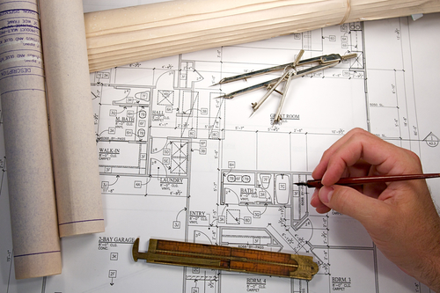
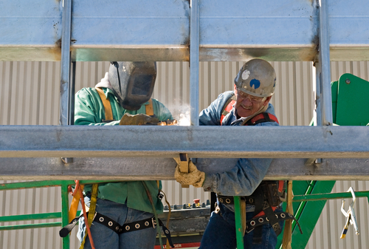
Why?
What?
How?
102

Slide 103
“An Owner needs to decide what it’s buying - a product - or a team to solve a problem that no one completely understands and that keeps changing.”
- Jim Carroll, Washington Group
103

Slide 104
Why?
What?
How?
104

Slide 105
What Underlies A Relational Contract?
Ian Macneil:
Relations of significant duration
Objects of “value” are not all easily measurable
Many individuals, collective poles of interest
Future cooperation anticipated
Benefits and burdens shared
Trouble is expected
Relations will vary as unforeseeable future unfolds

Slide 106
Integrated Project Delivery Contract
One Agreement signed by O-A-C
“Joined” by jointly selected team members
No separate “general conditions”
Provides for formation of:
  Core Group
  Integrated Project Delivery Team
  Senior Management Group
Incentives for team performance
Integrated Project Delivery Team
Owner
Architect
Contractor
Sr. Mgmt. Group
Core Group
Source: McDonough Holland & Allen PC, Attorneys at Law

Slide 107
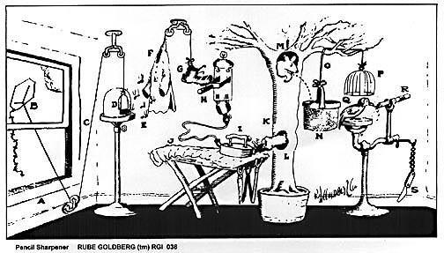
Traditional Project Delivery
Traditional Contracting limits cooperation and innovation. Inability to fully coordinate the project.
Good ideas are held back.
Owner
A/E Team
Builder
Source: McDonough Holland & Allen PC, Attorneys at Law

Slide 108
Integrated Project Delivery Team
Alignment / Integration / Collaboration
Landscape Design
Civil Engineer
Skin
Telecom
Owner
Drywall
Concrete
Structural Engineer
Architect
CM/GC PM
Mechanical Engineer
Steel
HVAC
Electrical Engineer
Plumbing
Core Group
Electrical
Fire Protection
Source: McDonough Holland & Allen PC, Attorneys at Law

Slide 109
Traditional Project Delivery
Level of Common Understanding
≤100%
Common
Understanding
Pre-Construction Services
Construction
Architect Hired
Engineers Hired
CM/GC Hired
Major Trades Hired
SD
DD
CD
Time
Source: McDonough Holland & Allen PC, Attorneys at Law
Notes:
109

Slide 110
Integrated Project Delivery Level of Common Understanding
100%
Common
Understanding
Construction
Pre-Construction Services
Architect Hired
CM/GC Hired
Engineers Hired
Major Trades Hired
SD
DD
CD
Time
Source: McDonough Holland & Allen PC, Attorneys at Law

Slide 111
Commercial Opportunities
Pool Contingencies
Trade Contractors’ Compensation
Create Proper Incentives (Rewards)
Create “Enterprise” Risk Sharing
Eliminate trade-level GMPs
Eliminate Project GMP
111

Slide 112
Basic Commercial Model
Expected
Cost
Estimated
Maximum Price
Target
Cost
Actual
Cost +
Fixed
Fees
DESIGN
CONSTRUCT
112

Slide 113
Sharing of Risk
Negligence
(Insurance $$)
Losses or Cost Overruns
or
Owner
IPD $$
(Profit Pool)
Owner $$
(IPD Cont.)
113

Slide 114
Sharing Project’s Innovation
Expected
Cost
Target
Cost
Savings $$
Owner =
Incentive Pool =
Metrics

Slide 115
The 5 Big Ideas
Collaborate;
Really Collaborate
Increase
Relatedness
Networks of
Commitment
Optimize
The Whole
Tightly Couple
Learning w/ Action
115

Slide 116
Sharing Project’s Production Success
Savings $$
Estimated
Max Price
Actual Cost
IPD
Contingency
Cost of Work
Owner =
Incentive Pool =
Metrics
116

Slide 117
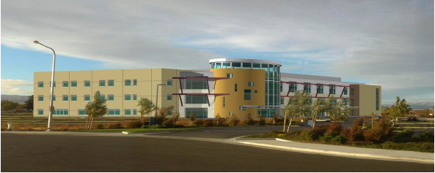
Owner Case: Sutter Fairfield MOB
The project was completed in 25 months, despite a 3 month delayed construction start.
The target cost ($18.9 million) was set 14.1% below the benchmark ($22.0 million). The actual cost ($17.9 million) for the original scope under ran the target by 5.3% and underran the benchmark by 18.6%.

Slide 118
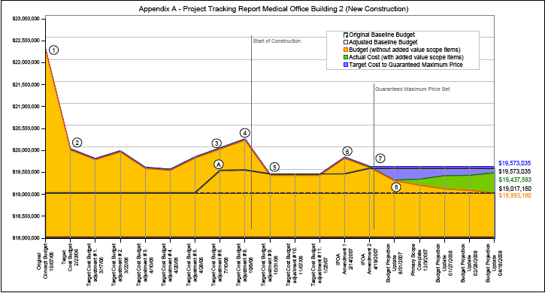
Sutter Fairfield MOB

Slide 119
Dave Koester, BMW Senior Project Manager, on using Lean Production Management on the BP ULSD Project
“Every large industrial project in Northwest Indiana and the south suburbs of Chicago has been over budget and has missed schedule for the last 20 years. This method broke the cycle.”
“We have been striving for employee involvement and empowerment; this method gave us a vehicle to achieve it.”
“We now utilize the entire bodies of our field crews, not just from the neck down.”
“If we didn’t use the method on this project, I would have been begging for mercy [from the owner] months ago.”

Slide 120
Key Features of Lean
Necessity, the mother of invention, is self-imposed to cause innovation and learning
Variation is attacked and reduced —variation in work load, in process durations, in product quality, in plan reliability, …
Inventory, capacity, schedule and financial buffers are sized and located to perform their function of absorbing variability that cannot yet be eliminated
The rule followed for release of work between connected specialists is: Flow where you can, Pull where you can’t, Push where you must
Activities are performed at the last responsible moment
The larger system is the focus of management attention, not local optimization
Stakeholder interests are aligned through relational contracts
All product life cycle stages are considered in design
Product and process are designed together; indeed, all design criteria are considered when generating and selecting from design options
Downstream players are involved in upstream work, and vice-versa
Notes:
Toyota’s approach has been adopted widely in manufacturing, and has even moved into service industries and construction. With the extension to new domains, adaptation of the initial approach has been required, and some re-invention of tools and techniques. On this slide we see some of the fundamental features of lean applied to project production systems—in which custom products are designed and made.
[You may want to discuss selected features in order to save time. Alternatively, ask people what they find counterintuitive or otherwise puzzling. I like to emphasize systems thinking, organizational integration, self-imposition of necessity, and the importance of attacking and reducing variation. Since you will have just completed the learning exercise, the last should certainly resonate with participants. If you have questions about any of these, let me know.]

Slide 121
Project Phases and Target Costing
Notes:
Target costing starts in the project definition phase and continues through the entire project, moving from setting targets to designing to targets and finally building to targets.
Targets are set in a conversation concerning ends, means and constraints. Targets may be set for any constraints that are conditions of value delivery to the customer.

Slide 122
Target Costing
FEEDBACK LOOP
Integrated team validates facility can be built for available funds
Sets target cost at or below allowable cost
Owner, architect and contractors work within market constraints
© Glenn Ballard, 2009

Slide 123
Target Value Design Clusters
M/E/P
Cardinal Rule:
“The target cost of a facility can never be exceeded.”
Teams composed of A/Es and contractors
Each designs to a target cost
Targets adjusted up and down to maintain project target cost
Building Envelope
Structure
Interior/ Finishes
Cluster Leaders
Site Improvements
Vertical Transportation
Landscape
Material Handling
Notes:
123

Slide 124
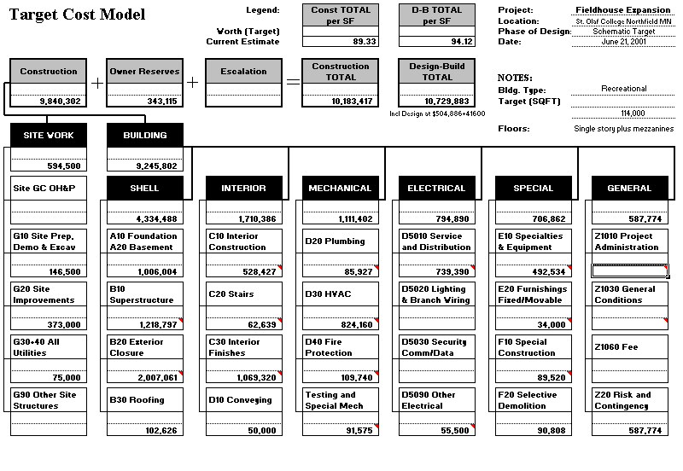

Slide 125
Target Costing vs. Conventional Project Management
 | St. Olaf College Fieldhouse | Carleton College Recreation Center
Completion Date | August 2002 | April 2000
Project Duration | 14 months | 24 months
Gross Square Feet | 114,000 | 85,414
Total Cost (incl. A/E & CM fees ) | $11,716,836 | $13,533,179
Cost per square foot | $102.79 | $158.44
Courtesy of the Boldt Companies

Slide 126
Notes:
Let’s look at one example project, Shawano Clinic. You see here the project cost budget and how the expected cost changed over time in relation to the target cost. Ultimately the target cost was very nearly achieved, along with a return to the owner of unused contingency and funding of owner changes without additions to the budget.

Slide 127
Shawano Clinic
Under Budget and Ahead of Schedule
3.5 months ahead of schedule –70 additional days of clinic revenue translating into nearly $1 mil. in the expanded imaging service line functions and additional revenue in the 2006 year.
Below the budget in spite of additional equipment costs and added service line.
Notes:
Shawano is an outpatient clinic with exceptional diagnostic capabilities, in part because of target costing. The project team delivered the project under udget and ahead of schedule, generated additional revenue for the owner, and added service capability in imaging beyond the initial scope.

Slide 128
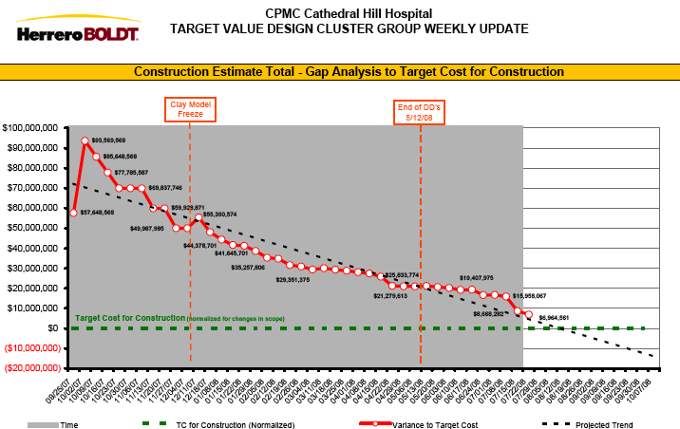

Slide 129
Set-Based Design
“Preventing engineers from making premature design decisions is a big part of my job.” (Toyota’s Manager of Product Engineering)
Notes:
However, Toyota is in this matter a leader, just as they are in factory production. Toyota's Manager of Body Engineering expressed their perspective well when he said that his job is to prevent premature decision making.
Toyota's product development process is structured and managed quite differently even than other Japanese automobile manufacturers.
Toyota’s product development:
Develops multiple design alternatives.
Produces 5 or more times the number of physical prototypes than their competitors.
Rejects changes that expand, rather than contract, the space of possible designs.
Puts new products on the market faster than their competitors.
THE POINT WAS MADE THAT TOYOTO DID NOT HAVE “SCHEDULED DESIGN MEETINGS” - FELT EVERYONE KNEW WHAT THEY SHOULD BE DOING AND MEETINGS WERE A WASTE OF TIME AND EFFORT
TODD MADE A SKETCH SHOWING DESIGN CRITERIA PLUS A BOX FOR EACH DISCIPLINE WITH 2 TO 5 ALTERNATE DESIGN CONCEPTS FOR EACH - THE POINT BEING YOU PICKED A “SET” OF DESIGNS FROM THE VARIOUS ALTERNATES (THIS DESCRIPTION OF “SET” WORKED FOR ME). MUCH DISCUSSION OF THE EFFORT PUT TO EACH ALTERNATE CONCEPT - TODD GAVE DIFFERENT ANSWERS AT DIFFERENT TIMES - WE NEED A STORY AS TO HOW MUCH IS DONE.

Slide 130
Principles of Set-Based Design
1. Map the design space.
2. Integrate by intersection.
3. Establish feasibility before commitment.
Notes:
WE NEVER TALKED ABOUT “MAPPING THE DESIGN SPACE”.
COULD WE GO BACK TO THE THEATER SEAT STORY SLIDE 160 - MAYBE SPEND MORE TIME THERE AND DO A REAL “MAP” THEN MAYBE POINT 2 WOULD MAKE MORE SENSE.
POINT 3 IS OBVIOUS BUT PERHAPS COULD BE RELATED TO “LAST RESPONSIBLE MOMENT”
I THINK “POINT BASED” DESIGN GOT LOST IN THE SHUFFLE - NEED AN ACTUAL COMPARISION TO DEMONSTRATE WHY ONE IS BETTER

Slide 131
Advantages of Set-Based Design
1. Enables reliable, efficient communication.
  Vs point-based design, in which each change may invalidate all previous decisions.
2. Waste little time on detailed designs that can’t be built.
3. Reduces the number and length of meetings.
4. Bases the most critical, early decisions on data.
5. Promotes institutional learning.
6. Helps delay decisions on variable values until they become essential for completion of the project.
7. Artificial conflicts and needless iterations of negotiations are avoided.
8. The initiator of a change retains responsibility for maintaining consistency.
Notes:
I DOUBT ANYONE IN THE SEMINAR WOULD UNDERSTAND OR AGREE WITH THESE ADVANTAGES BASED ON THE PREVIOUS MATERIAL.

Slide 132
Key Features of Lean
The larger system is the focus of management attention, not local optimization
Variation is attacked and reduced —variation in work load, in process durations, in product quality, in plan reliability, …
Inventory, capacity, schedule and financial buffers are sized and located to perform their function of absorbing variability that cannot yet be eliminated
Stakeholder interests are aligned through relational contracts
Necessity, the mother of invention, is self-imposed to cause innovation and learning
The rule followed for release of work between connected specialists is: Flow where you can, Pull where you can’t, Push where you must
Activities are performed at the last responsible moment
Standards are the starting point for improving how work is done
Downstream players are involved in upstream work, and vice-versa
Product and process are designed together; indeed, all design criteria are considered when generating and selecting from design options
All product life cycle stages are considered in design
© Glenn Ballard, 2008

Slide 133
Five Big Ideas
Collaborate;
Really Collaborate
Increase
Relatedness
Optimize
The Whole
Innovation
Competitive
Continuous
Improvement
Build
Trust
Reliability
Projects as
Networks of
Commitment
Tightly Couple
Learning w/ Action

Slide 134
Next Steps?
…

Slide 135
Plus Delta
…
…

